Slide 1
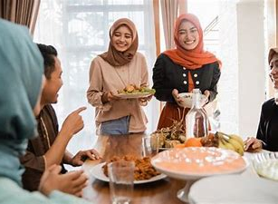
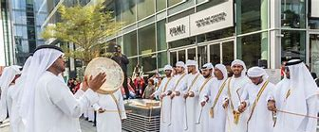
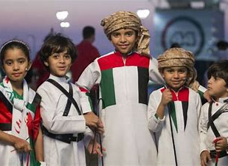
Lessons 7-8: Family Celebrations
Coursebook p8
Workbook p8

Slide 2
Warm Up:
What holidays and special days do you celebrate with your family?
Create a mind up about that
An untitled mindmap (mindmup.com)

Slide 3
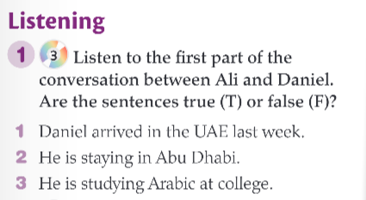

Listening for general idea:

Slide 4
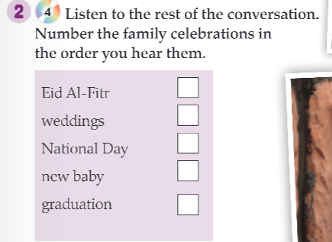
Listening for details:

Slide 5
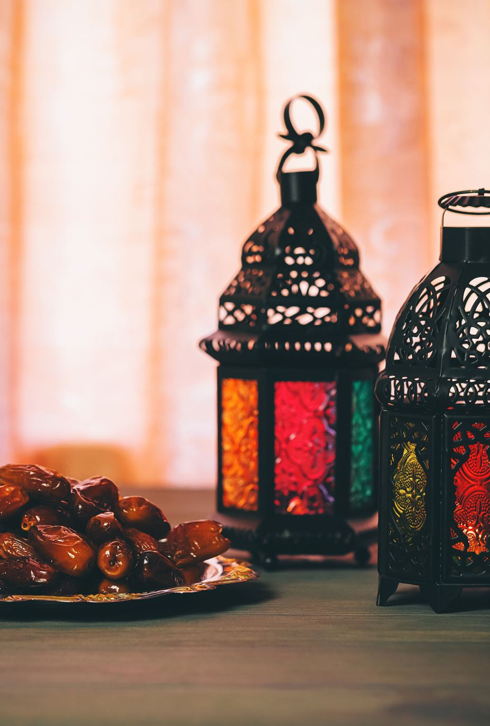
Discussion:
What does Ali’s family do to celebrate Eid Al- Fitr?

Slide 6
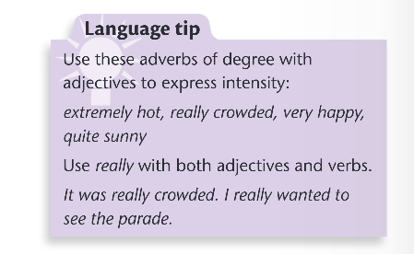

Language: Adverbs of Degree:

Slide 7
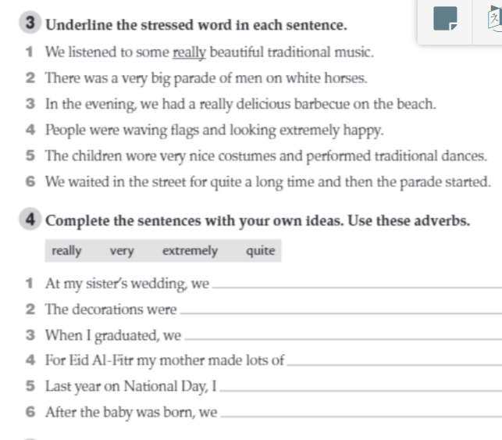
Let’s check our understanding: Workbook p 9

Slide 8
Plenary:
Write 3 sentences about celebrations in the UAE using an adverb of degree

