Slide 1


Stage 3 Academic Writing
Unit 2 Lesson 3
Lesson Objectives:
By the end of the lesson, we will be able to ...
Understand the meaning of words related to the topic of ‘celebrity athletes’
Recognize words that help us structure an essay
Read and analyse a text to find the main points and arguments.
Listen and identify the main points and ideas.

Slide 2
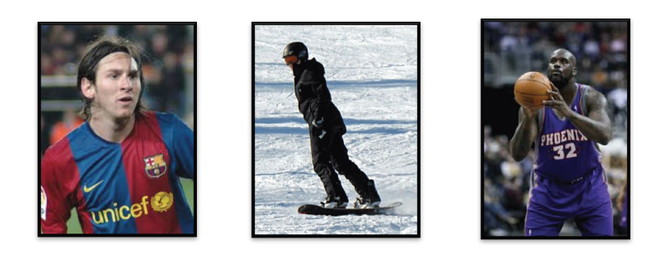
Name their jobs
football player
snowboarder
basketball player

Slide 3
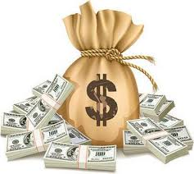
Who do you think gets paid the most?
Let’s vote
https://www.menti.com/eibinzd71x

Slide 4

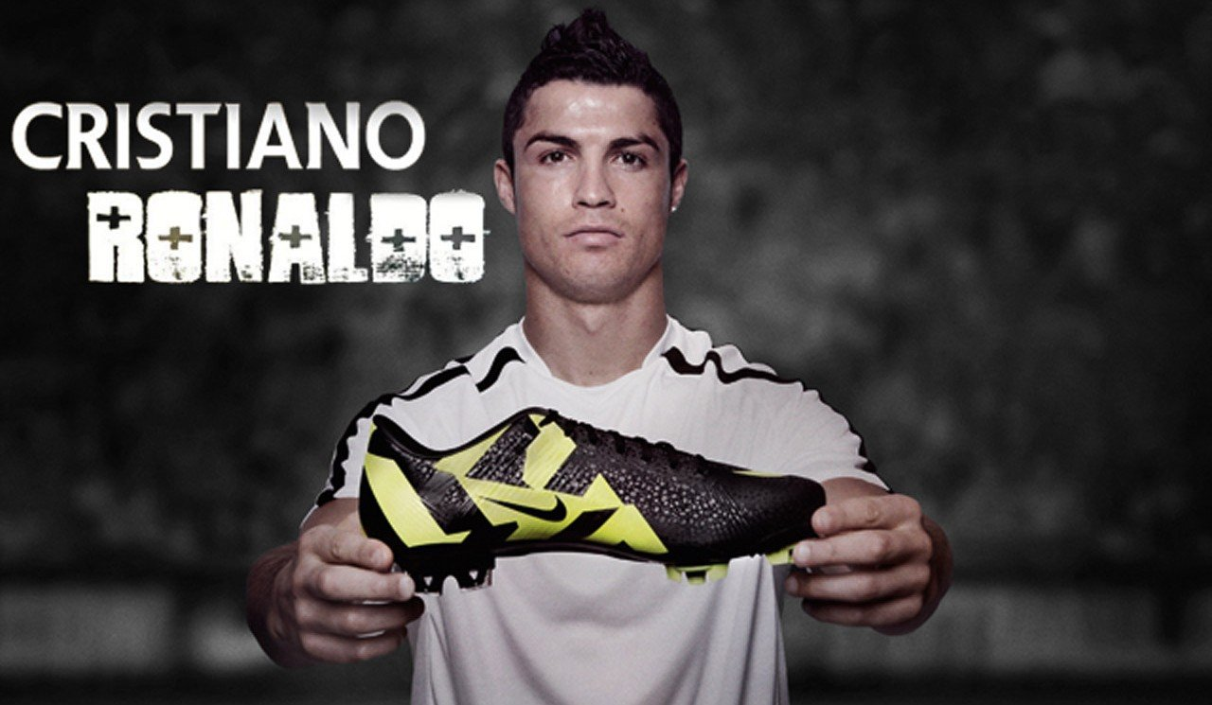
A famous person; well known
a celebrity (n)

Slide 5
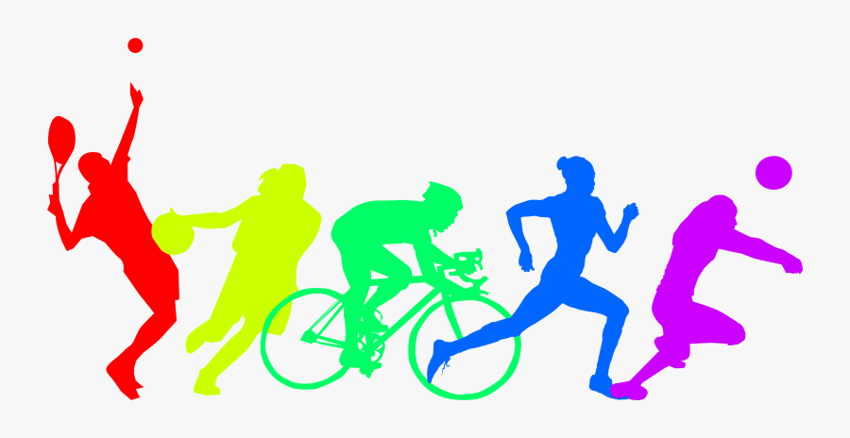
A person who is excellent at sports and
takes part in competitive events
an athlete (n)

Slide 6

Attention given to someone by the media
publicity (n)

Slide 7


When no one can hear or see what you are doing;
they cannot know your information
privacy (n)

Slide 8

A job that you do for a large part of your life
a career

Slide 9
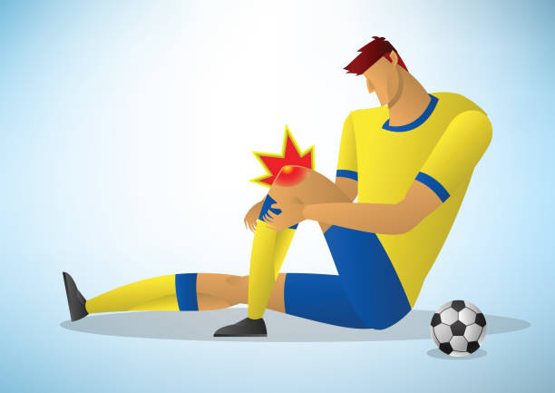
Damage to the body
an injury (n)

Slide 10

To work hard and practice something to be good at it.
to train (v)

Slide 11


To leave your job and
stop working
to retire (v)

Slide 12
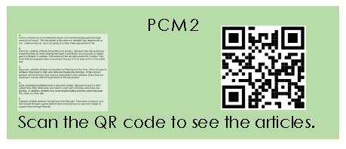

Slide 13
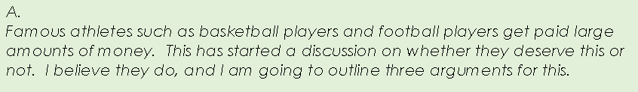
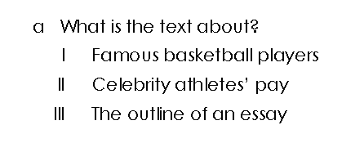
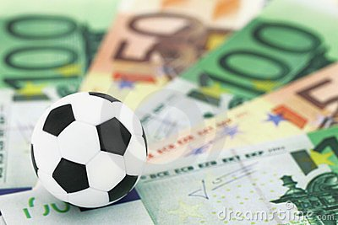
How do you know this?

Slide 14
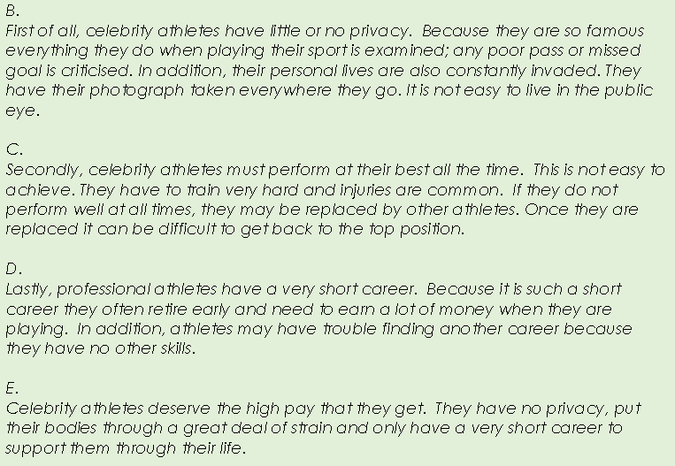
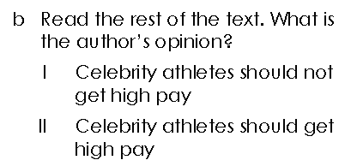

Slide 15

How does the writer structure their essay?
Do they use paragraphs?
How many?
How many arguments do they mention?
What words do they use to order their arguments?

Slide 16
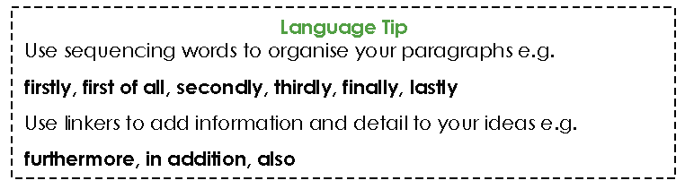
Read the essay and write a list of the sequencing words in the chat.

Slide 17
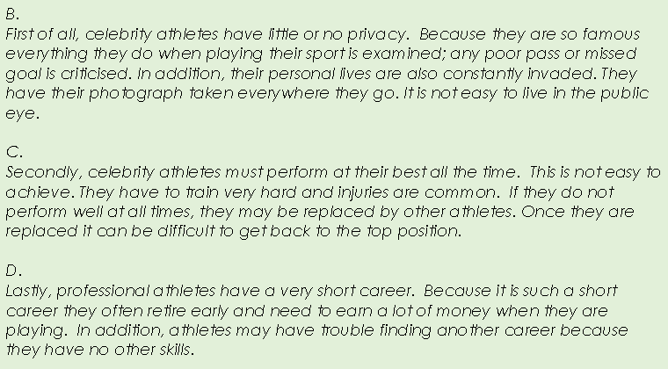

Slide 18
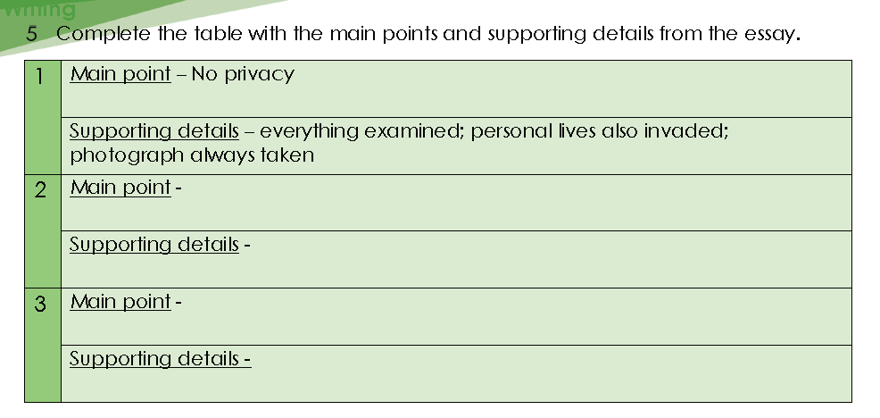

Slide 19
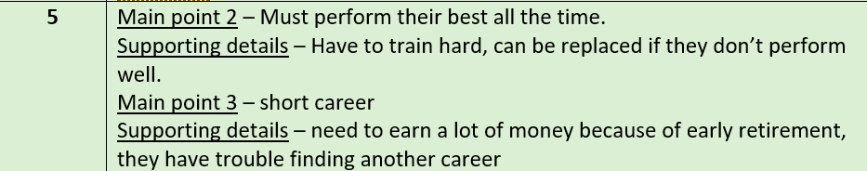
Answers:

Slide 20
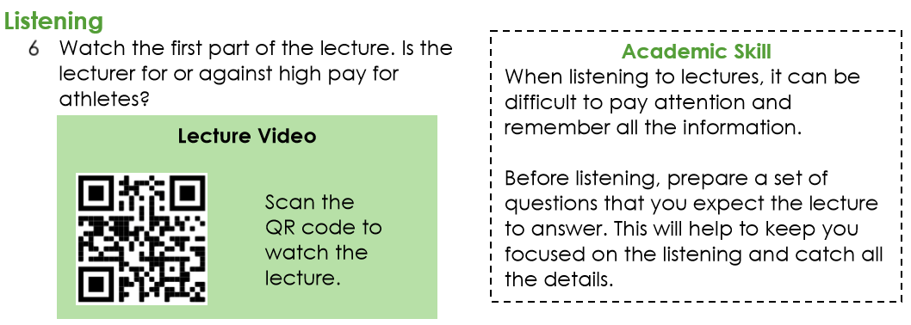
https://edushare.moe.gov.ae/Uploads/Resources/12cd757e-d304-489c-86b8-6fd2aba9d577/Stage%203%20Unit%202.mp4

Slide 21
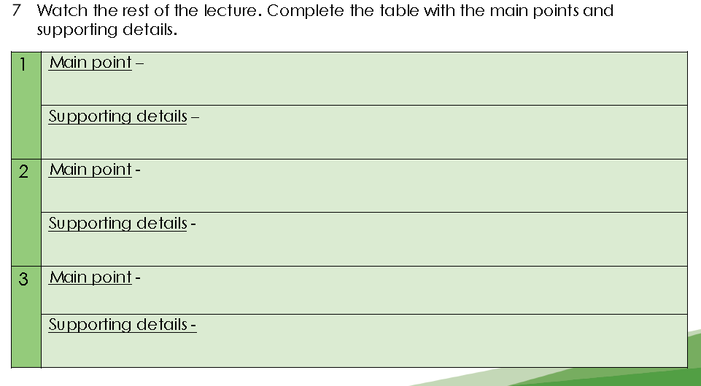
https://forms.office.com/Pages/ShareFormPage.aspx?id=ZN_eq0qrBUuqA_TbXZ4ii4hojQcUTDBHgXMCk6ZgZXhUODZUOTg4WjRPMVdSTjVQUTBMTkNXMU1YUy4u&sharetoken=L9EhRTWDpPmfh7sgCqRv

Slide 22
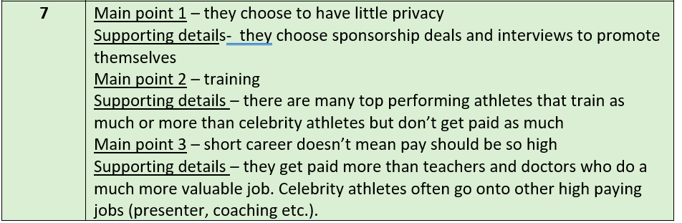
Answers

Slide 23
Stage 3 Academic Writing
Unit 2 Lesson 4
Lesson Objectives:
By the end of the lesson, we will be able to ...
Brainstorm our ideas in order to prepare for the writing task
Produce a structured text that contains a topic sentence and supporting ideas.

Slide 24
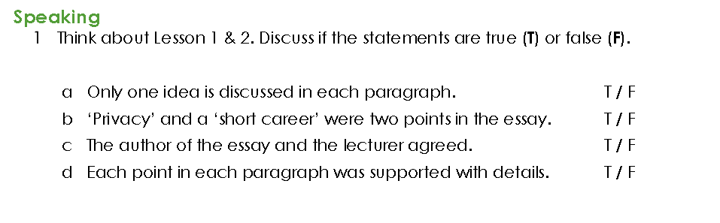

Slide 25
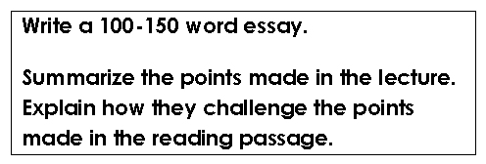
https://forms.office.com/Pages/ShareFormPage.aspx?id=ZN_eq0qrBUuqA_TbXZ4ii4hojQcUTDBHgXMCk6ZgZXhUMVlGRU9GQkQzQzJLMk4yNVFHM1U4T0paMi4u&sharetoken=bpX6NwC68I0SdW0ODlNh

Slide 26
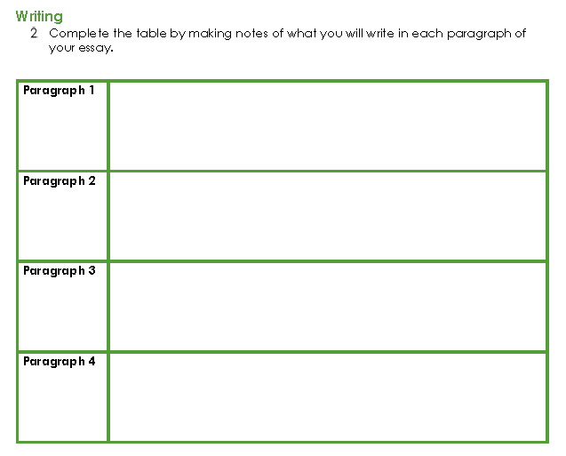

Slide 27
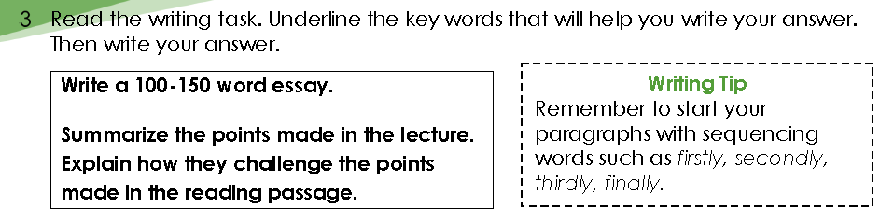

Slide 28
Example essay
Choose the correct words to complete the sentences.
https://www.liveworksheets.com/fk1294103nr

Slide 29
Dear teacher,
I am not doing the writing task in the Academic Writing book Unit 2 Lesson 4 Activity 3. Instead I am going to get my
students to write their essay about Social Media as this is the topic they are studying in their coursebook this week
due to time constraints etc,
So the question is on the following slides.
I will either use the Microsoft forms link to the question which I will add, or I will create an assessment task
on LMS where they will upload their document with the writing task there.

Slide 30

Social Media

Slide 31

Write an argumentative essay
Using social media has a negative impact on society
and individuals.
Do you agree or disagree?
What should you do when you first see the question?
Highlight the key words

Slide 32
Planning
Brainstorm your ideas
- spend 5 minutes
- For this type of essay – decide whether you agree or disagree.
- Think of your main points and ideas to support
2. Write the essay (30 minutes) – (Homework)
3. Edit your essay (5 minutes)
- check you have used paragraphs
- have you used capital letters and full stops?
- check your spelling

Slide 33
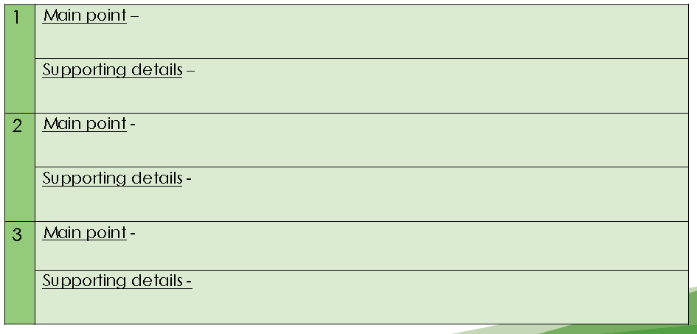
1. Brainstorm your ideas in your notebook. (You can do this in the writing exam)
2. Always look at/think about the question.
For example
Using social media has a negative impact on society
and individuals.
Do you agree or disagree?
Stay connected with friends/family easier
Due to Covid 19
- Many live in different areas/countries
Disagree – social media is positive
OR
3. _______
-
-
2. ______
-
-

Slide 34

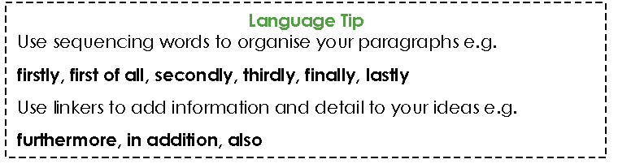
2. Write the essay
Use your own ideas from the mind map
Use your own words
Use the words and grammar from the lesson about social media
Unit 3 Lessons 5-6
Remember:

Slide 35
https://forms.office.com/Pages/ShareFormPage.aspx?id=ZN_eq0qrBUuqA_TbXZ4ii4hojQcUTDBHgXMCk6ZgZXhUNVVXUUY3MFo5NVlGSkRJMEhaREpaU1dDNy4u&sharetoken=Wz9bbOwVZ8GI0csGYWxs

Slide 36


3. Edit the essay
CHECK LIST
I have used clear paragraphs
I have used words to help order (sequence) the
paragraphs and ideas (firstly; secondly, etc)
I have used words related to the topic.
I have checked my spelling
Then you are ready to…

Slide 37
Exit Ticket
Why do we use words like Firstly, Secondly…?
Why do we use words/phrases like In addition, Also ..?

