Slide 1
Revision Grade 3
Final Exam

Slide 2
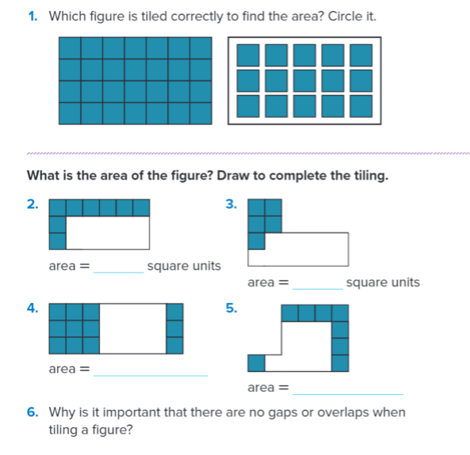
Demonstrate an understanding of the concepts of area measurement?

Slide 3
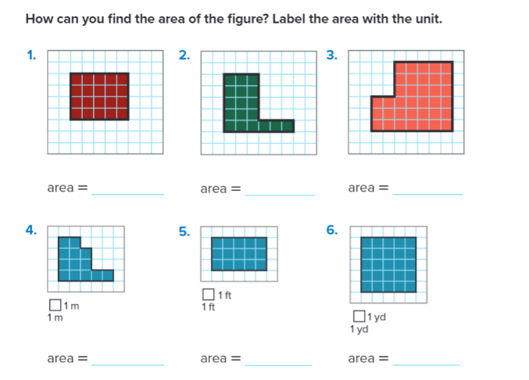
Determine area by counting unit squares?

Slide 4
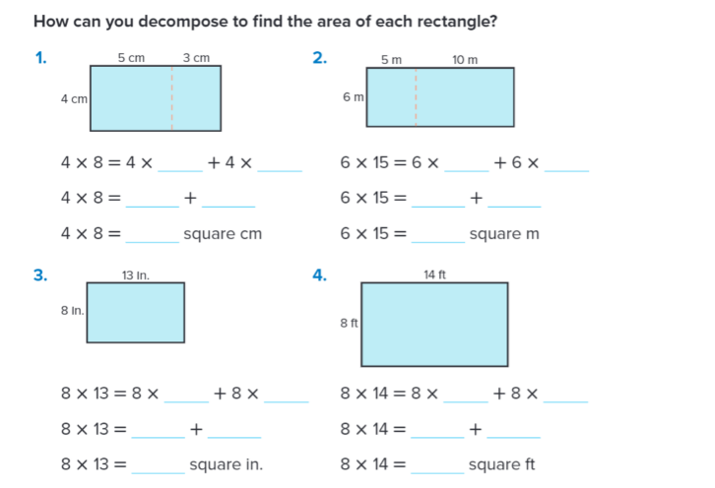
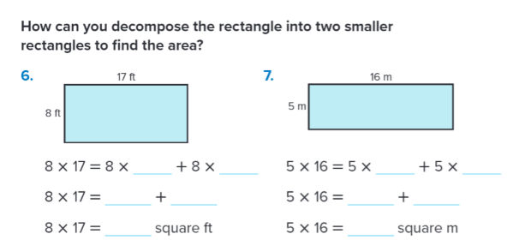
Determine the area of a rectangle by decomposing a side length using the Distributive Property?

Slide 5
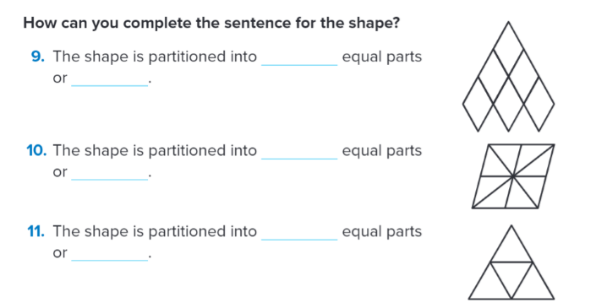
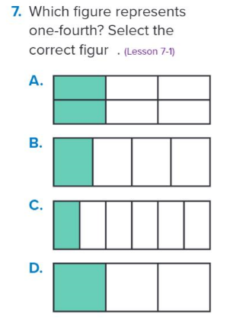
Use the number of parts to describe the equal parts of a shape?

Slide 6
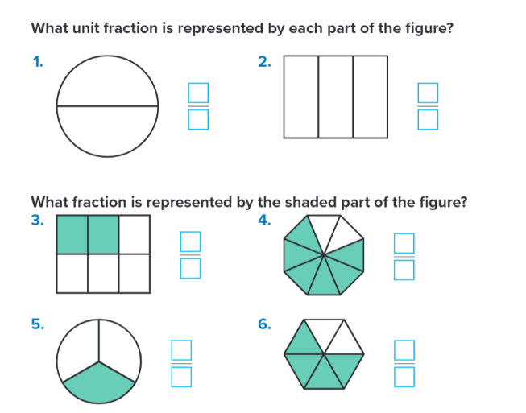
Identify and represent fraction?

Slide 7
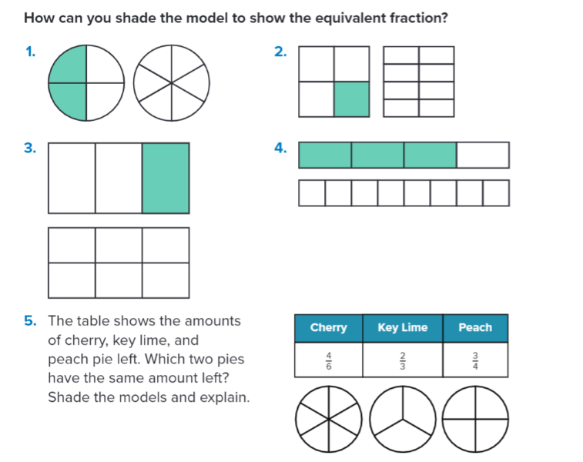
Determine whether two fractions are equivalent

Slide 8
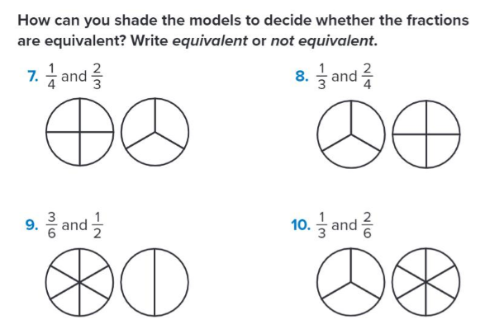

Slide 9
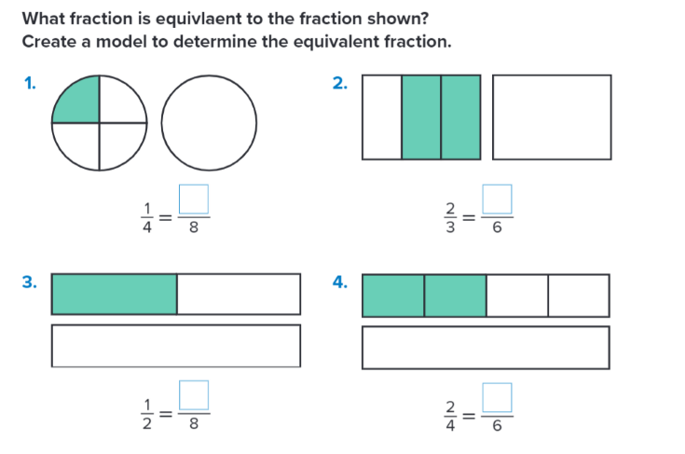
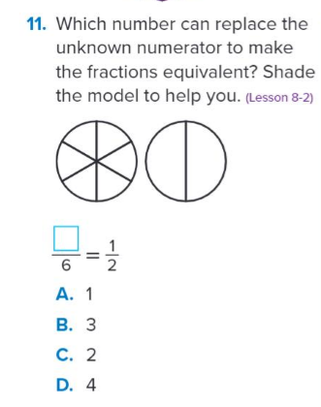

Slide 10
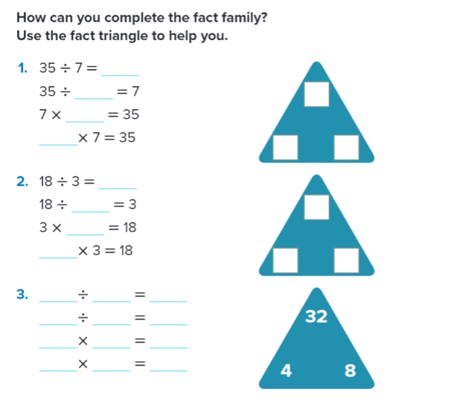
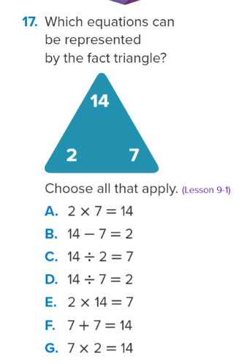

Slide 11
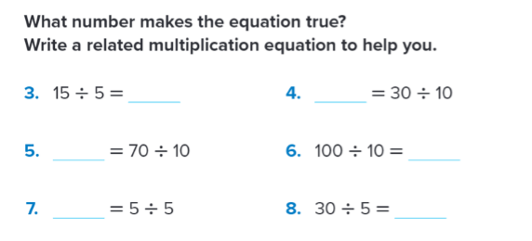
Use related multiplication facts to divide by 5 and 10?

Slide 12
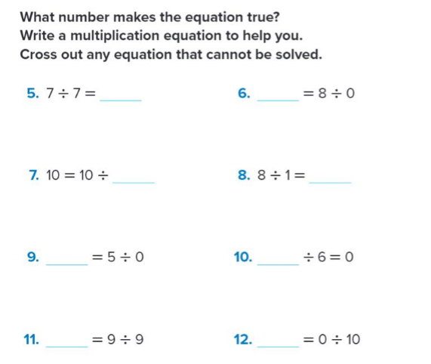
Use patterns and rules to recall division facts with 1 and 0?

Slide 13
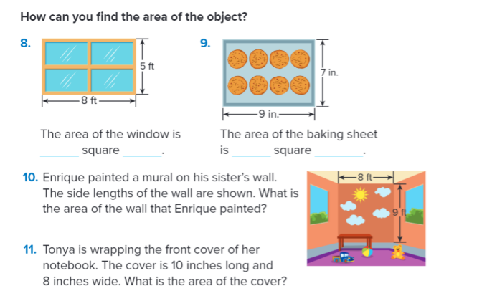
Multiply the length of a rectangle by its width to determine its area ?

Slide 14
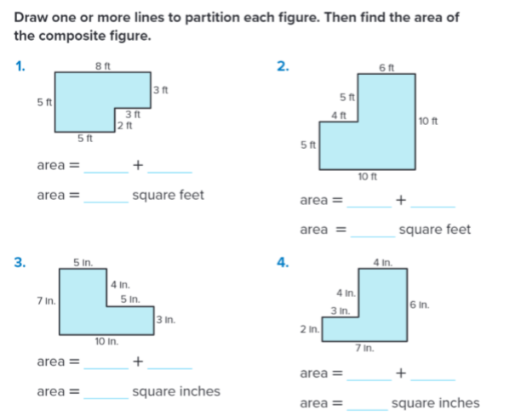
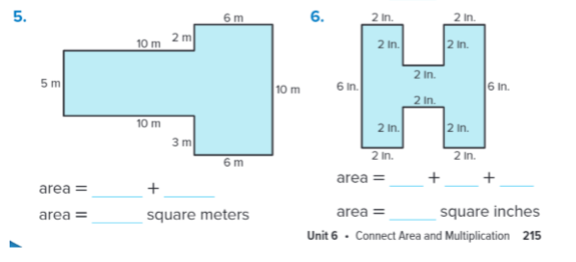
Determine the area of composite figures?

Slide 15
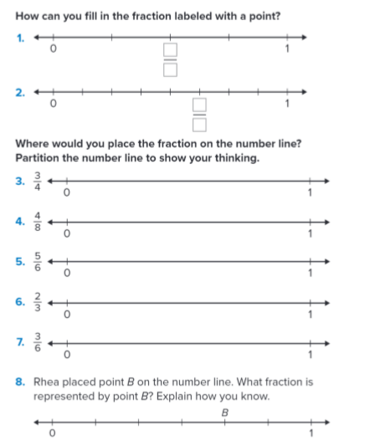
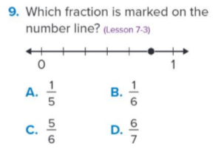

Slide 16
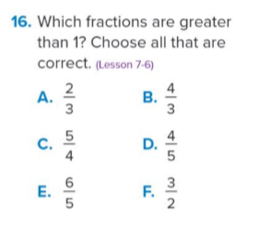
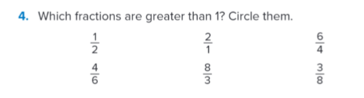
Represent fractions greater than one on a number line?

Slide 17
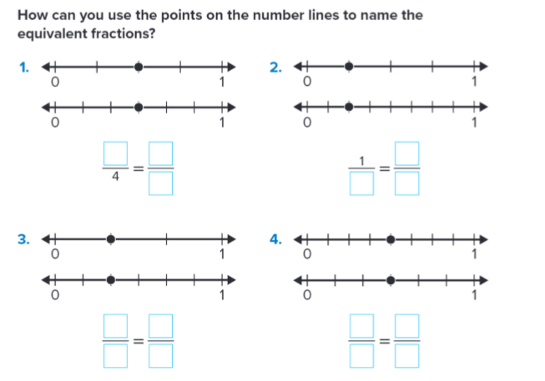
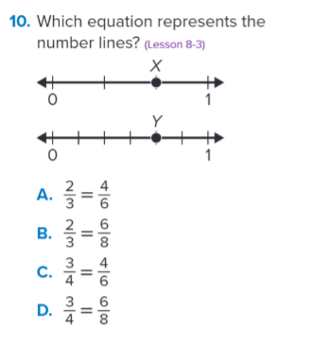
Use number lines to determine and generate equivalent fractions?

Slide 18
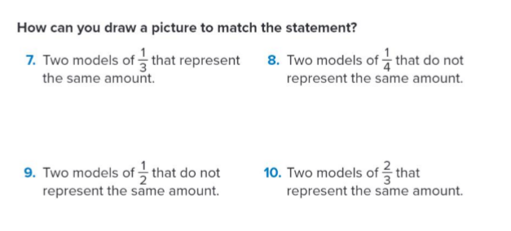
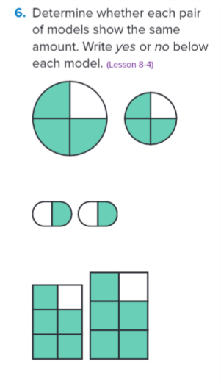
Explain why fraction comparisons are valid only when the wholes are the same size ?

Slide 19
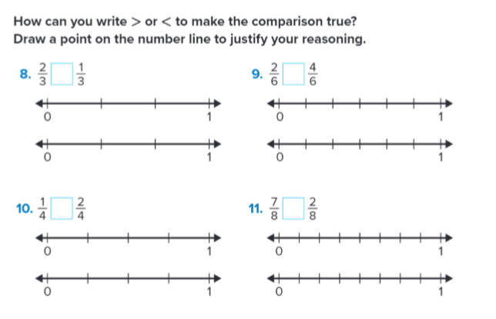
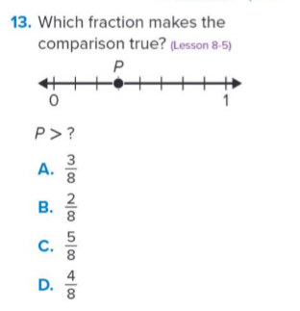
Explain why fraction comparisons are valid only when the wholes are the same size ?

Slide 20
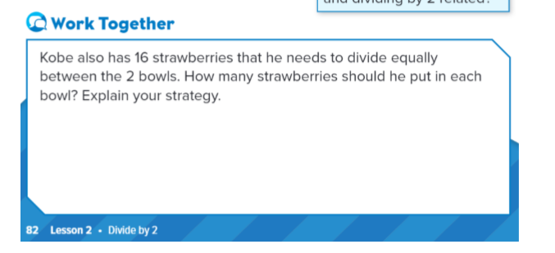
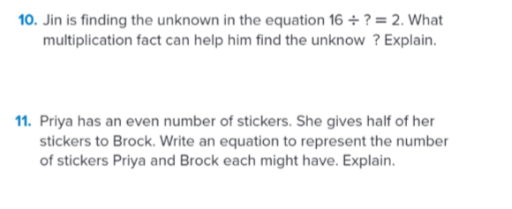
Use related multiplication facts to divide by 2?

Slide 21
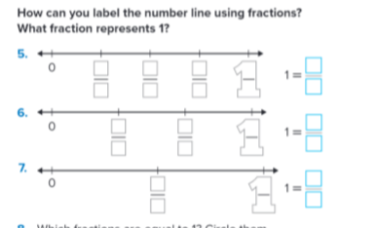
Represent fractions equal to one whole?

Slide 22
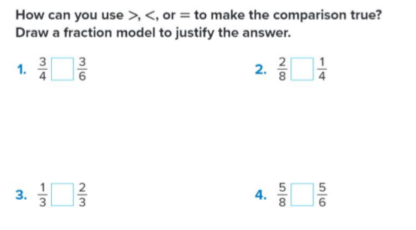
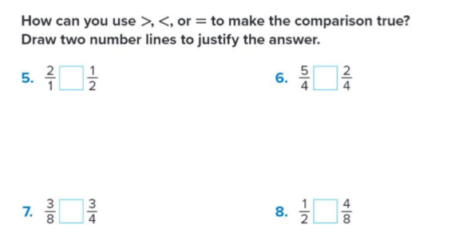
Compare two fractions and justify their comparison using fraction models or number lines?

Slide 23
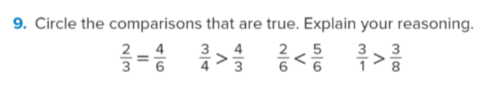
Compare two fractions and justify their comparison using fraction models or number lines?

Slide 24
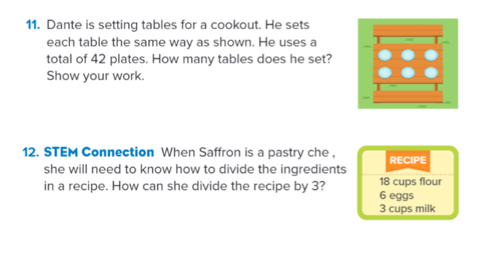
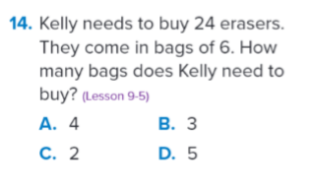
Use related multiplication facts to divide by 3 and 6?

