Slide 1

Unit 10 : Great explorations
Lessons 8&9 Space exploration:
The past & The future

Slide 2
Learning objectives:
Reading: To scan a text for specific information; to summarize paragraphs with headings
Writing: To write a factual paragraph based on research.
Speaking: To make predictions using will/won’t and the future passive.

Slide 3
Key words
Spacecraft
Astronaut
Planets
Unmanned
Knowledge
Gravity
Universe
Researched
Prediction

Slide 4
Key words
Spacecraft
Astronaut
Planets
Unmanned
Knowledge
Gravity
Universe
Researched
Prediction
1. A vehicle used for travelling in space.
2. A person who is trained to travel in a spacecraft.
3. Large object that moves around a sun.
4. Without any people.
5. facts, information, and skills learned through experience or education.
6. The force that makes something fall to the ground.
7. Space and everything in it.
8. Look for information.
9. Guess what will happen in the future.

Slide 5
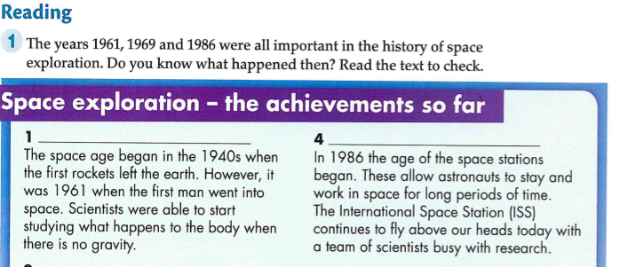

Slide 6
The beginning
Space Stations
Answer

Slide 7
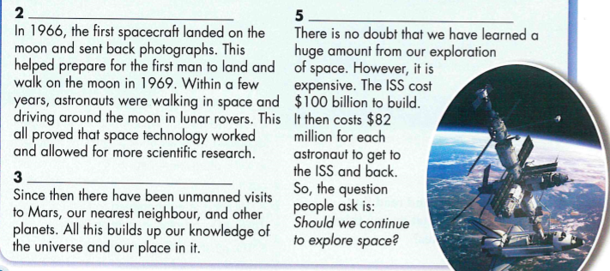

Slide 8
Moon exploration
The Cost
Unmanned Exploration

Slide 9
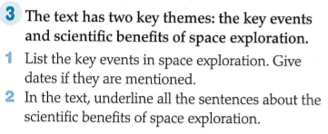

Slide 10
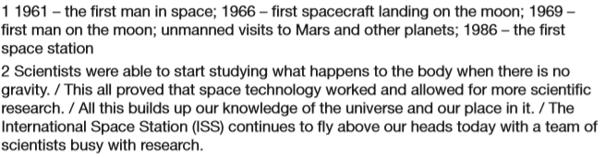

Slide 11
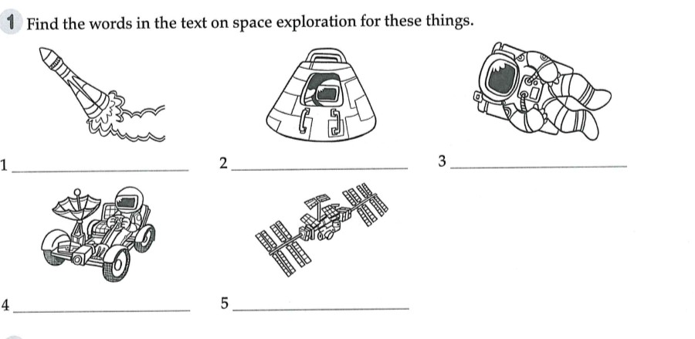

Slide 12
Rocket
Spacecraft
Astronaut
Lunar rover
Space station

Slide 13
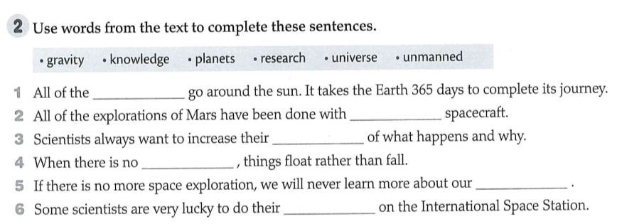

Slide 14
planets
unmanned
knowledge
gravity
universe
research

Slide 15
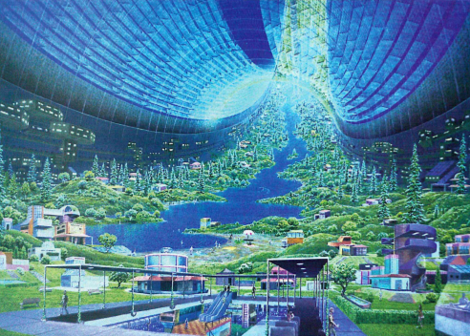
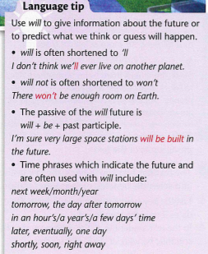


Slide 16
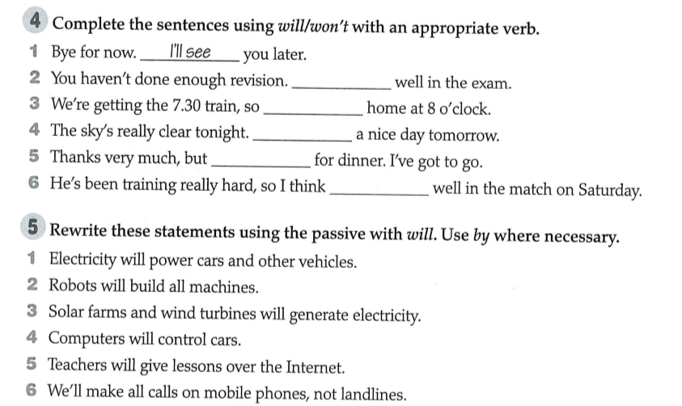

Slide 17
You won’t do
you’ll be
It’ll be
I won’t stay
he’ll do

Slide 18
