Slide 1


Slide 2


Slide 3


Slide 4


Slide 5
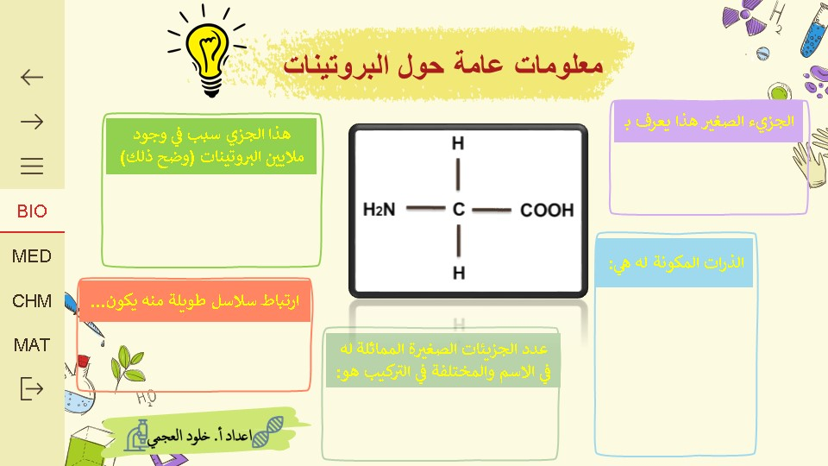

Slide 6
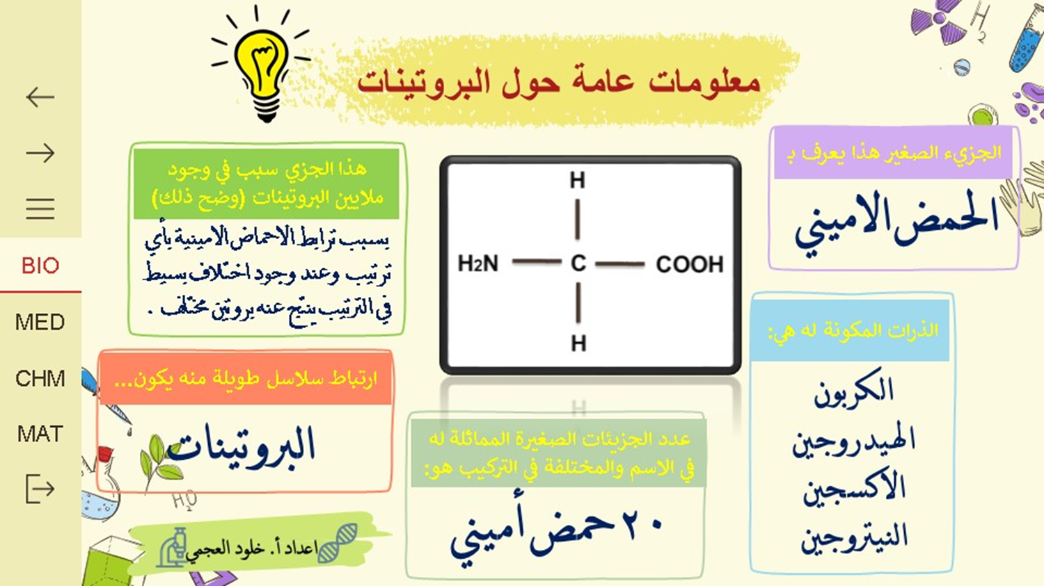

Slide 7
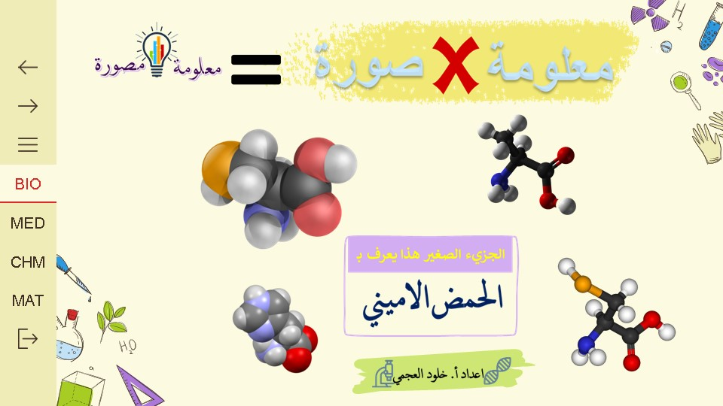

Slide 8
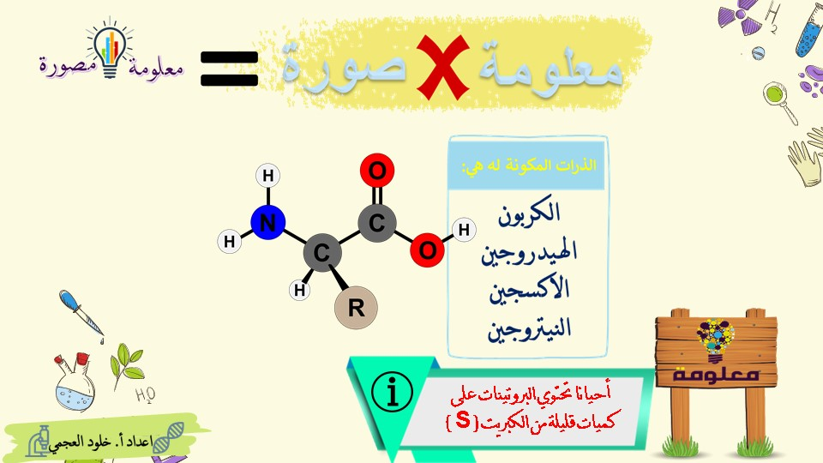

Slide 9
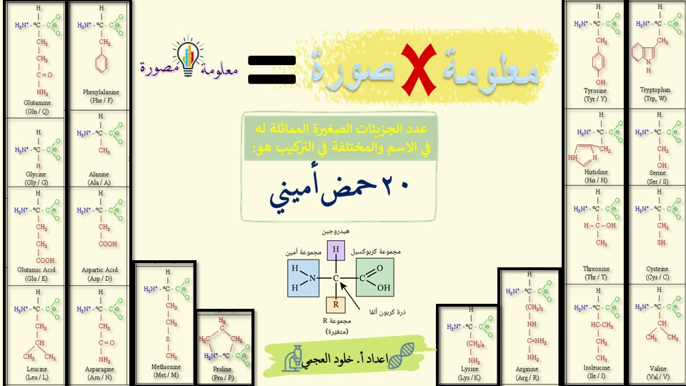

Slide 10
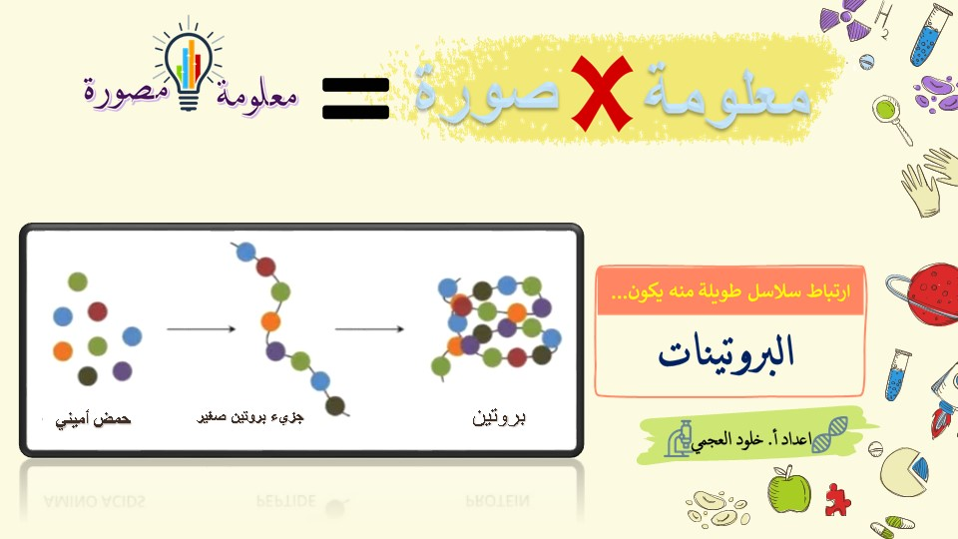

Slide 11
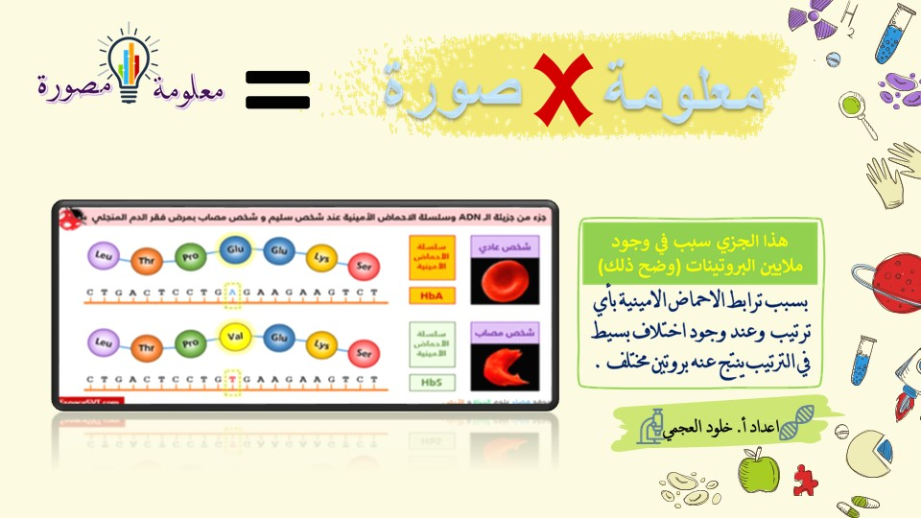

Slide 12
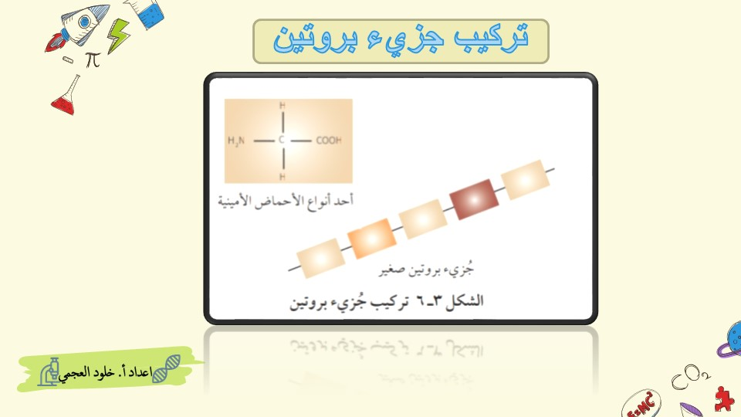

Slide 13
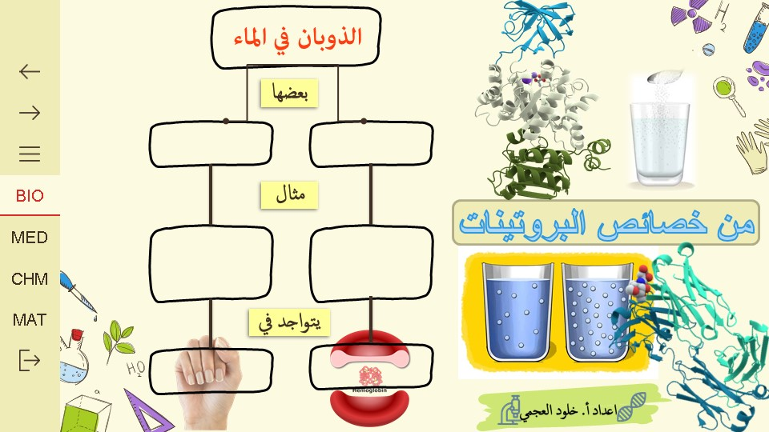

Slide 14
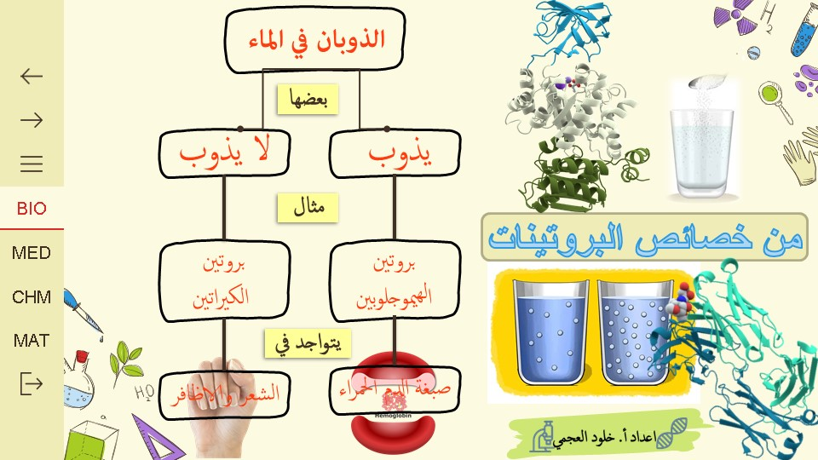

Slide 15
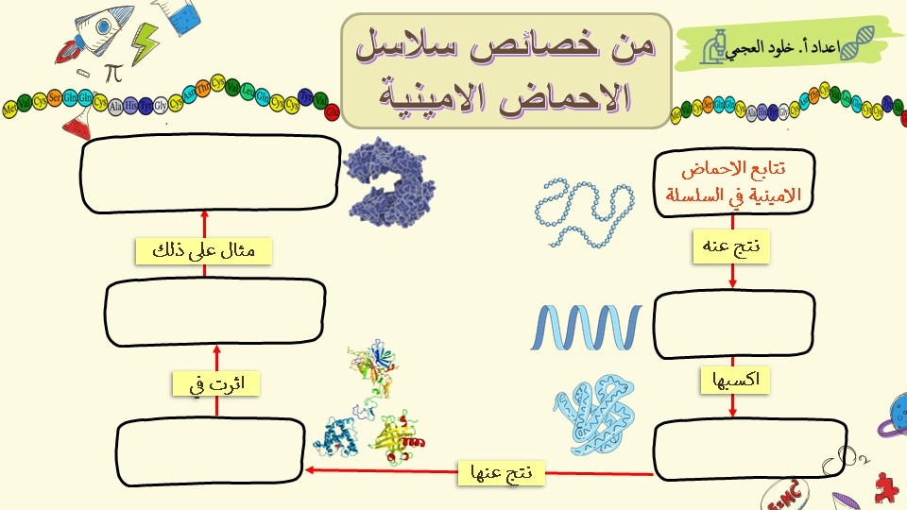

Slide 16
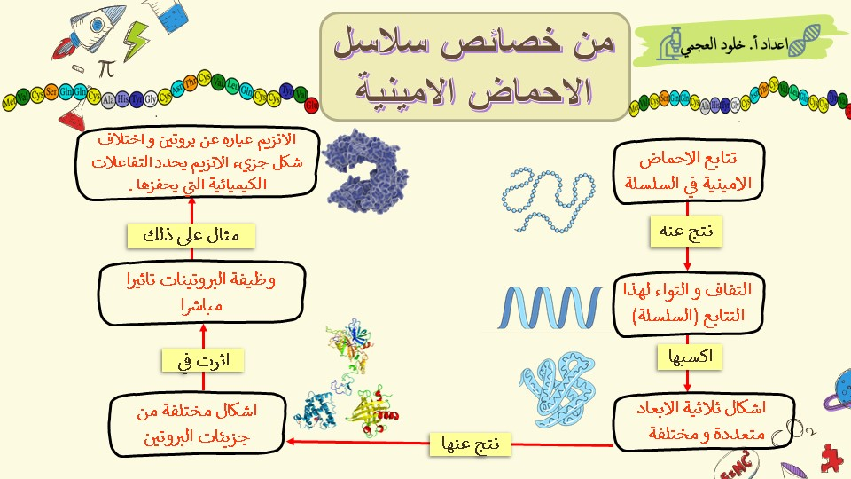

Slide 17


Slide 18


Slide 19
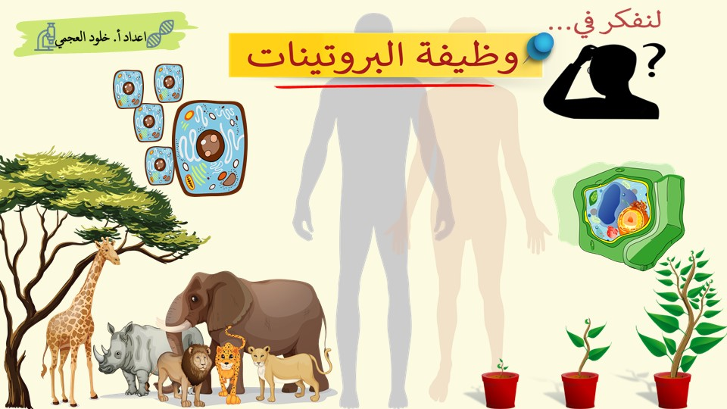

Slide 20
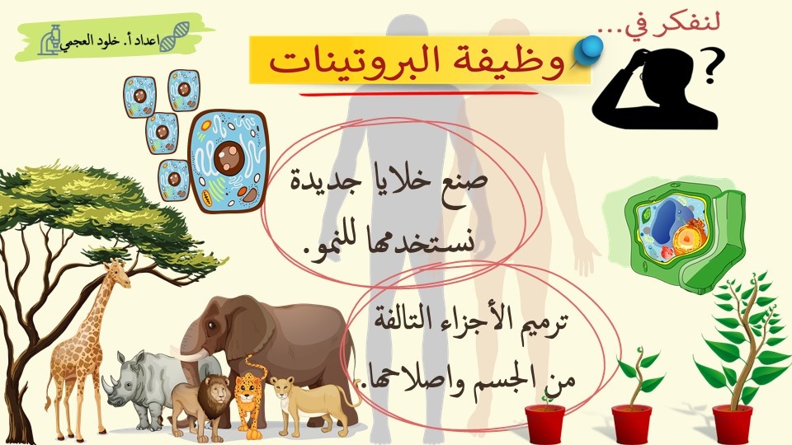

Slide 21
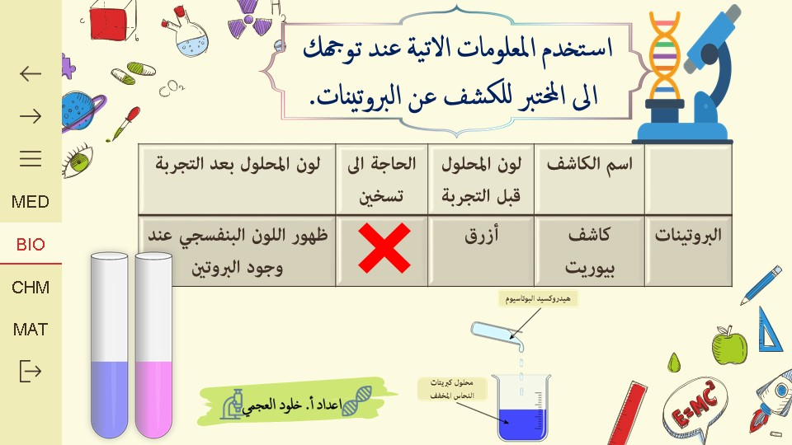

Slide 22


Slide 23


Slide 24


Slide 25
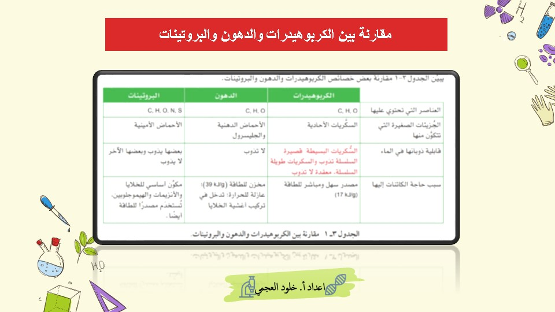

Slide 26

https://www.youtube.com/watch?v=O2HIgTOe1DE
https://www.youtube.com/watch?v=TZ3cnxRZp_Y
https://www.youtube.com/watch?v=3alwLHa8YAs

Slide 27
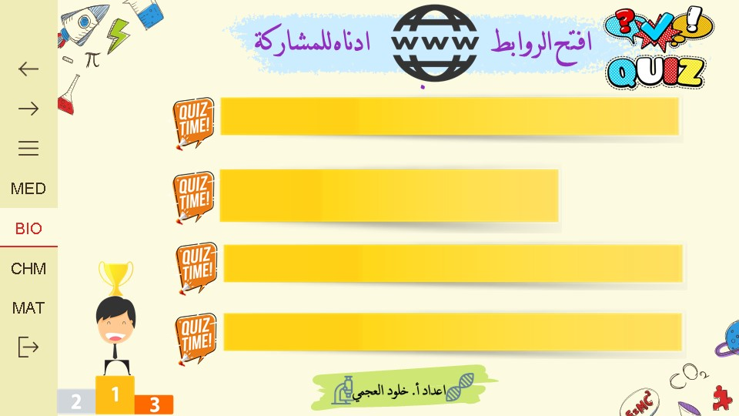
https://www.liveworksheets.com/zk1458261sh
https://www.liveworksheets.com/oq1452102vq
https://www.liveworksheets.com/gj1440644ot
https://www.liveworksheets.com/yp1459271vv

