Slide 1
Unit 4
The Art of Advertising
Writing
Mega Goal 1.1
Done by: Entisar Al-Obaidallah

Slide 2
Lesson Objectives
Write notes about a product.
Discuss the reading passage.
Find out some information about a product.
Put the information on a timeline.

Slide 3
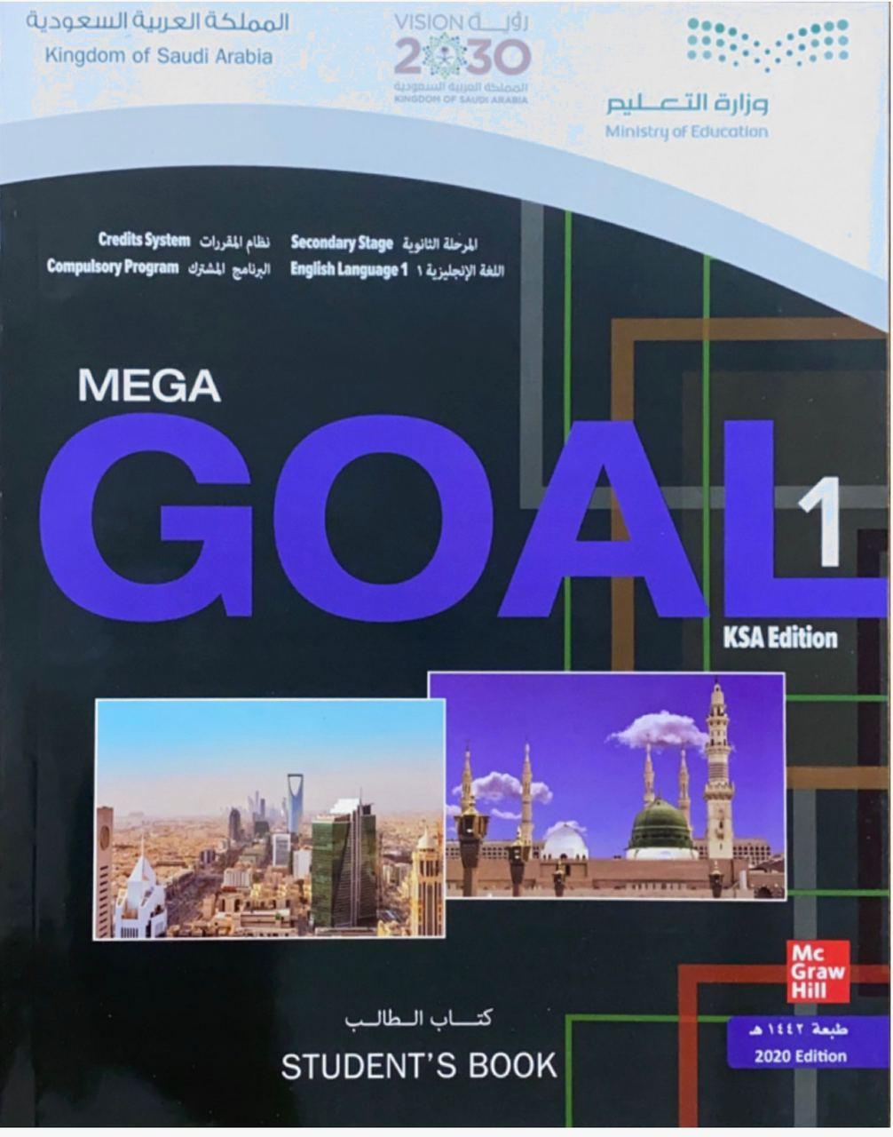
Open
Your student’s book ,
P. (56)

Slide 4
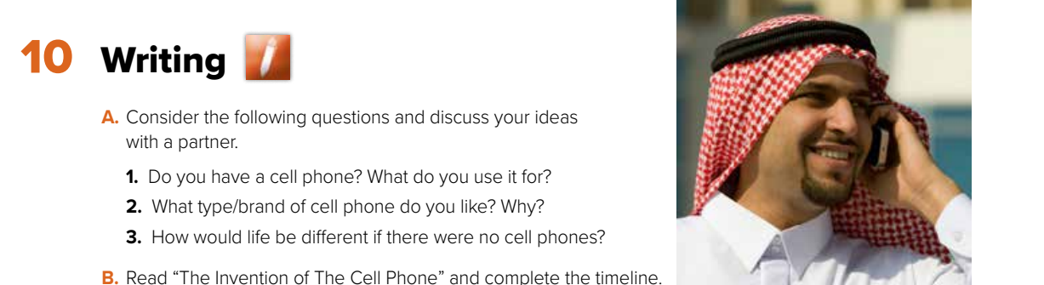
Let’s discuss the following questions

Slide 5
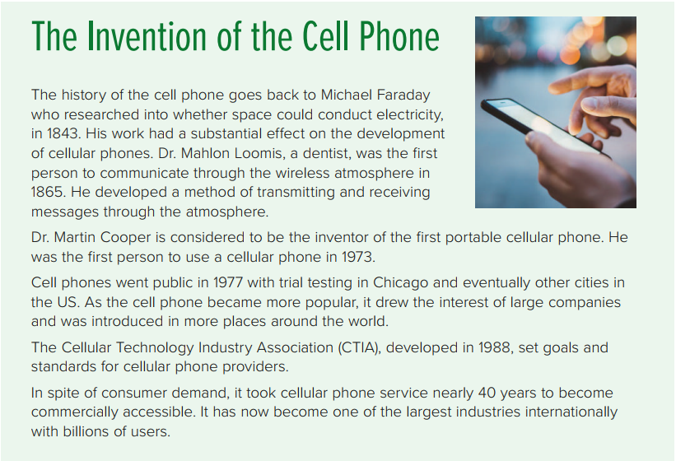

Is the cell phone
an invention?
When do you think it was invented?
What kind of information do you expect to find in the
text?

Slide 6
What is the title ?
Name three persons are mentioned in this text?
What does CTIA stands for?

Slide 7
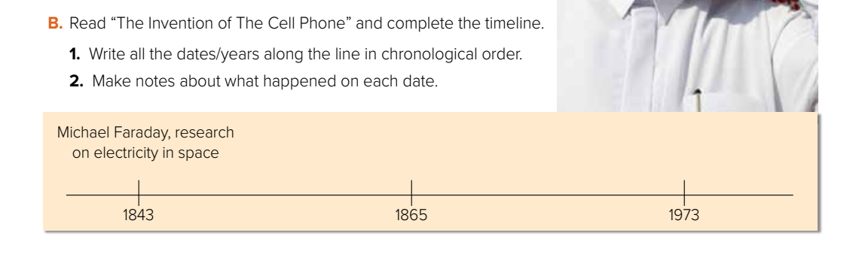
Dr. Mahlon Loomis, communication through wireless atmosphere
Dr Martin Cooper, first user of cellular phone
1977 Cell phones go public in USA
1988 CTIA, goals & standards for cellular phone providers

Slide 8
Open
Your student’s book ,
P. (57)

Slide 9
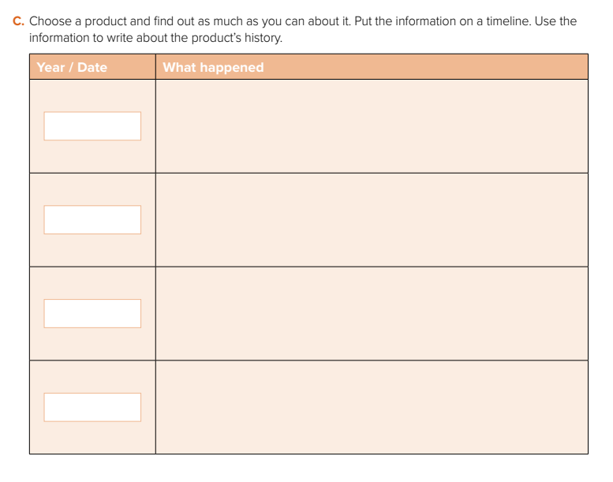
Steve Jobs announced the first iPhone
will be released.
Jan. 9 ,2007
June 11,2007
The first iPhone was released.
Apple released the iPhone 3G and launched apple store with an initial 500 applications available.
2008
Apple introduced the iPhone 4S with
a beta version of Siri.
2011

Slide 10
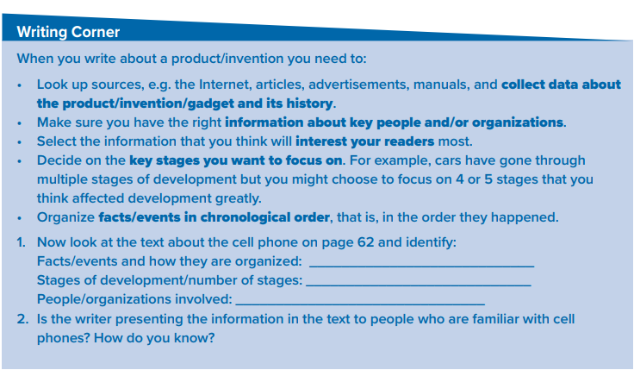
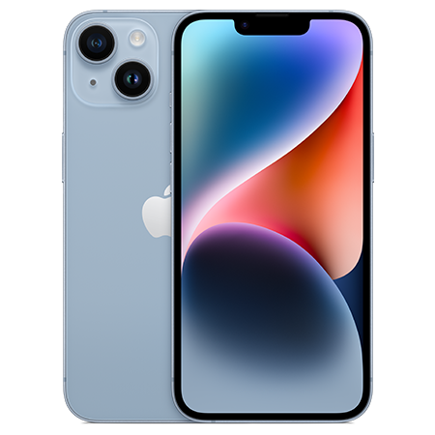
Follow these steps when you write about a product

Slide 11
Follow these steps when you write about a product
5 main stages of development
1. Facts and events are organized in chronological order, as marked along the timeline.
1843 Michael Faraday, research on electricity in space/ substantial effect on development /cellular phones – Stage 1
1865 Dr. Mahlon Loomis, communication through wireless atmosphere, developed method receiving/transmitting messages through atmosphere –Stage 2
1973 Dr Martin Cooper, first user of cellular phone/ invented first portable cellular phone – Stage 3
1977 Cell phones go public in USA/ trial testing/Chicago then other cities, attracted large companies/ introduced around the world.- Stage 4
1988 CTIA – Cellular Technology Industry Association, goals & standards for cellular phone providers – Stage 5
40 years later commercially accessible
Now one of the largest industries worldwide
Michael Faraday, Dr. Mahlon Loomis, Dr Martin Cooper, Cellular
Technology Industry sociation, CTIA.

Slide 12
Follow these steps when you write about a product
2- Yes, the writer is addressing people who are familiar with cell phones.
He doesn’t present or define cell phones as a new item.

Slide 13
Homework
Workbook P. (262) ,
exercise (K)

Slide 14

Thanks!

