Slide 1

Chores
Unit 2

Slide 2
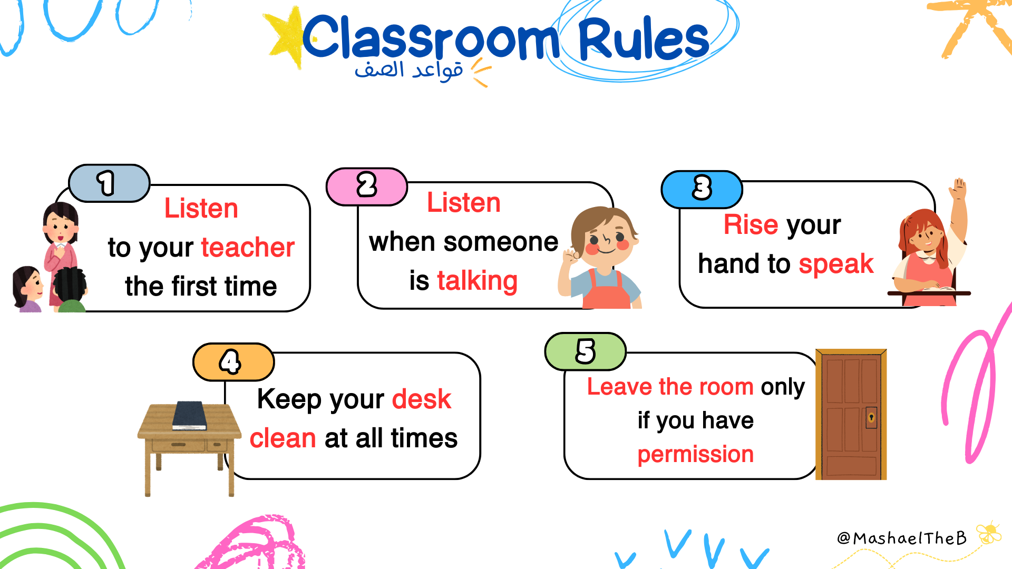

Slide 3
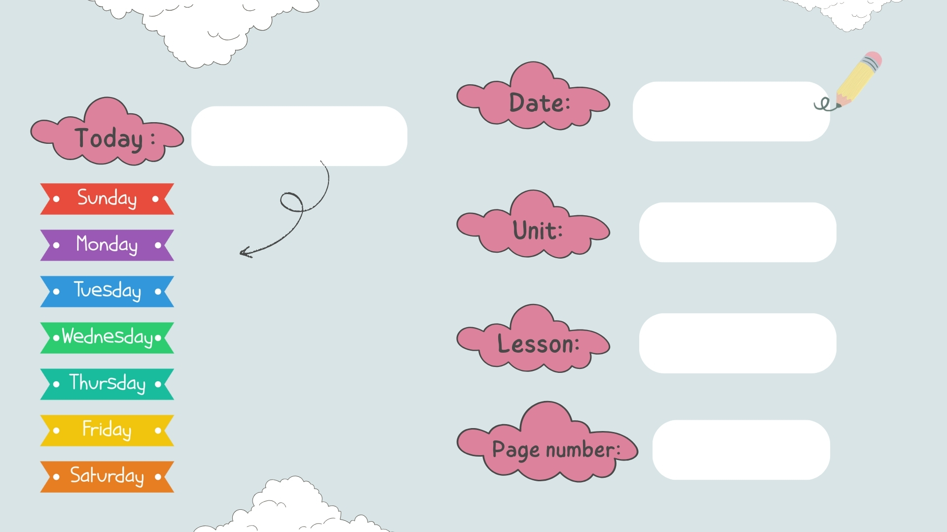
chores
Integrated learning & unit review
32 - 33

Slide 4


Slide 5
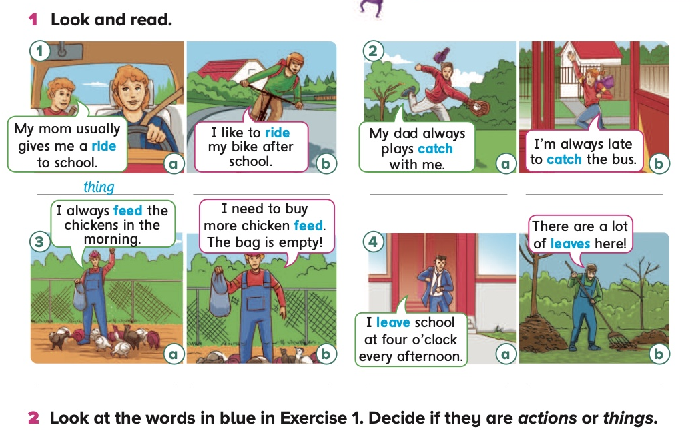
action
thing
action
action
thingc
action
thing

Slide 6
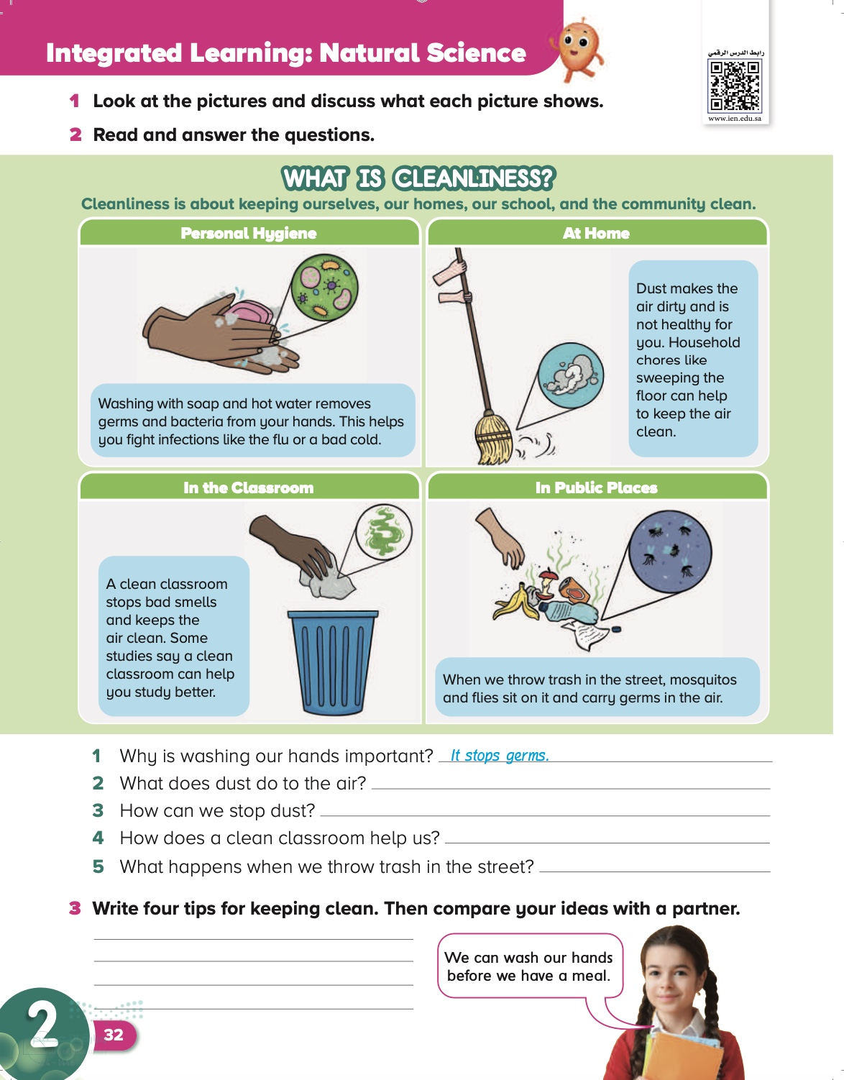
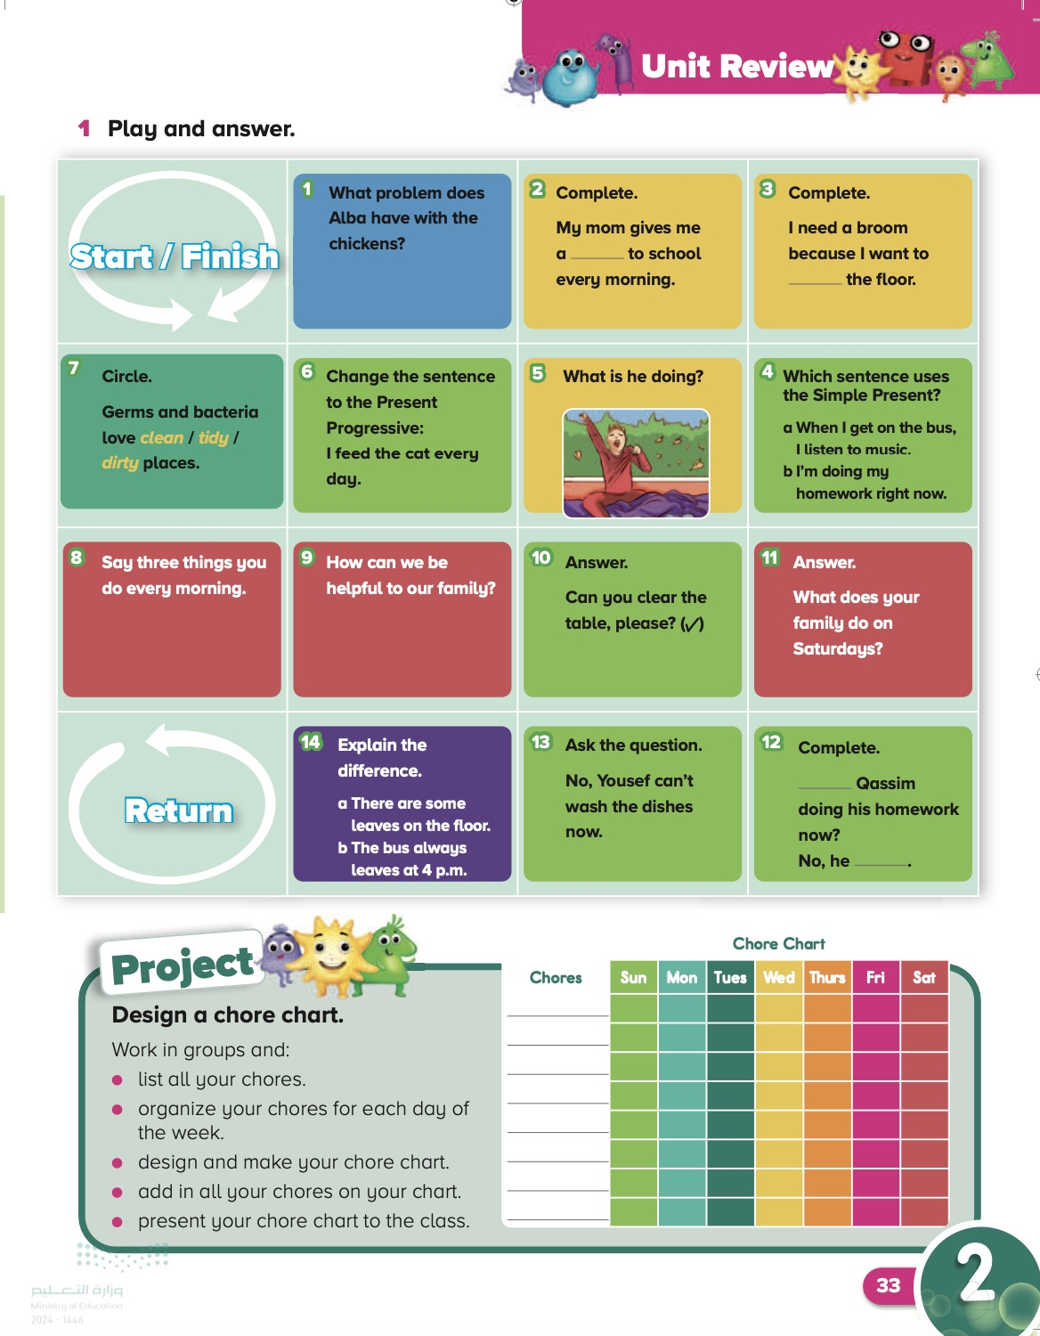
Date
Page:
32-33

Slide 7
Objective
By the end of this lesson, students should be able to read a text about cleanliness, answer questions about it, and write four tips for keeping clean.
By the end of this lesson, students should be able to remember what they have learned in Unit 2,and create a fun project.

Slide 8
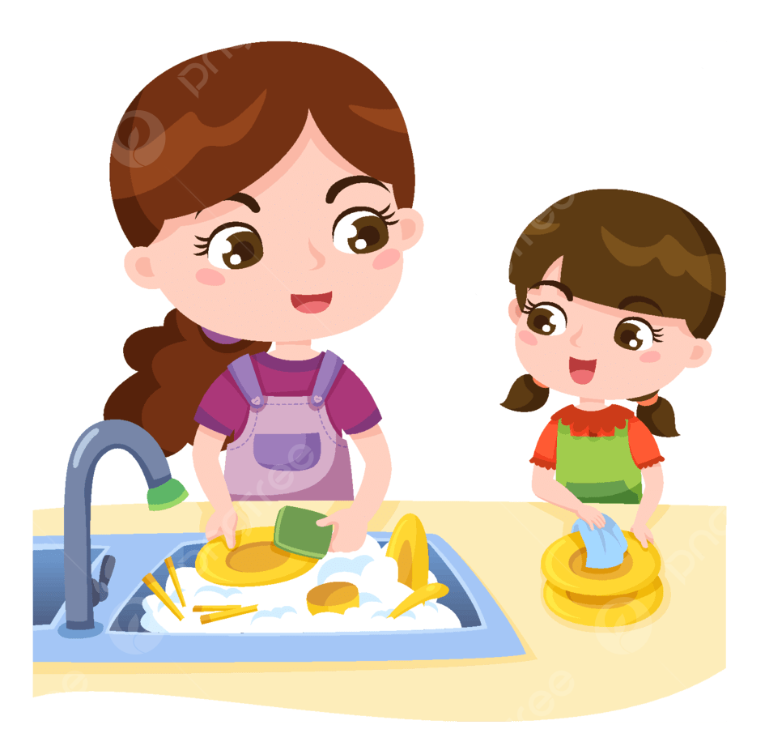

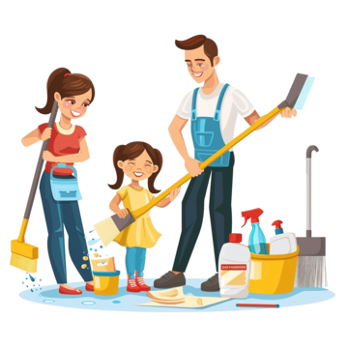
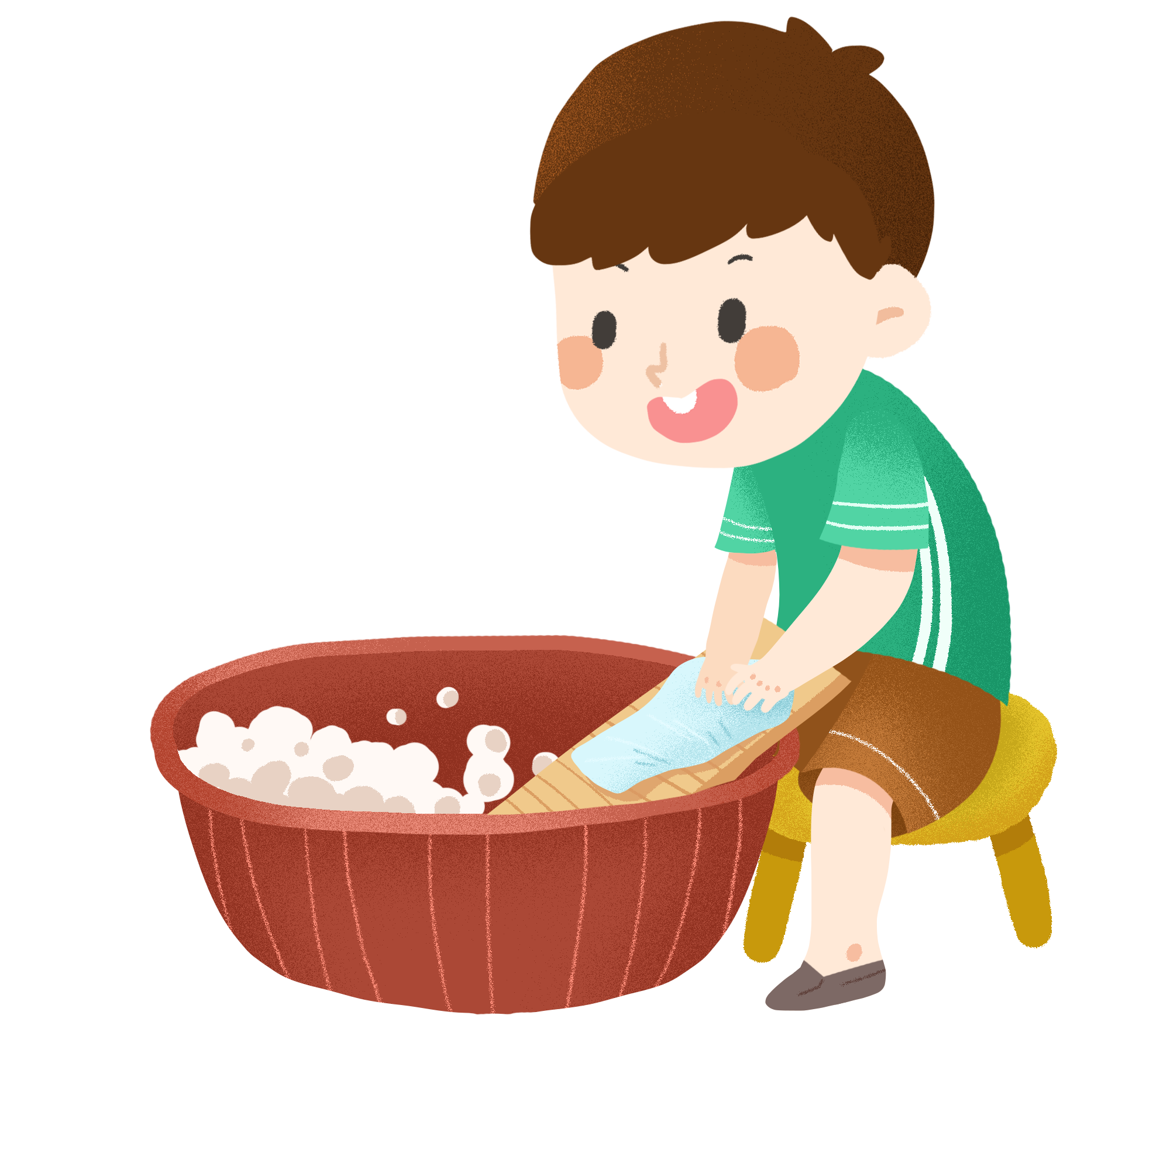

Can You Guess The Meaning Of
Chores

Slide 9
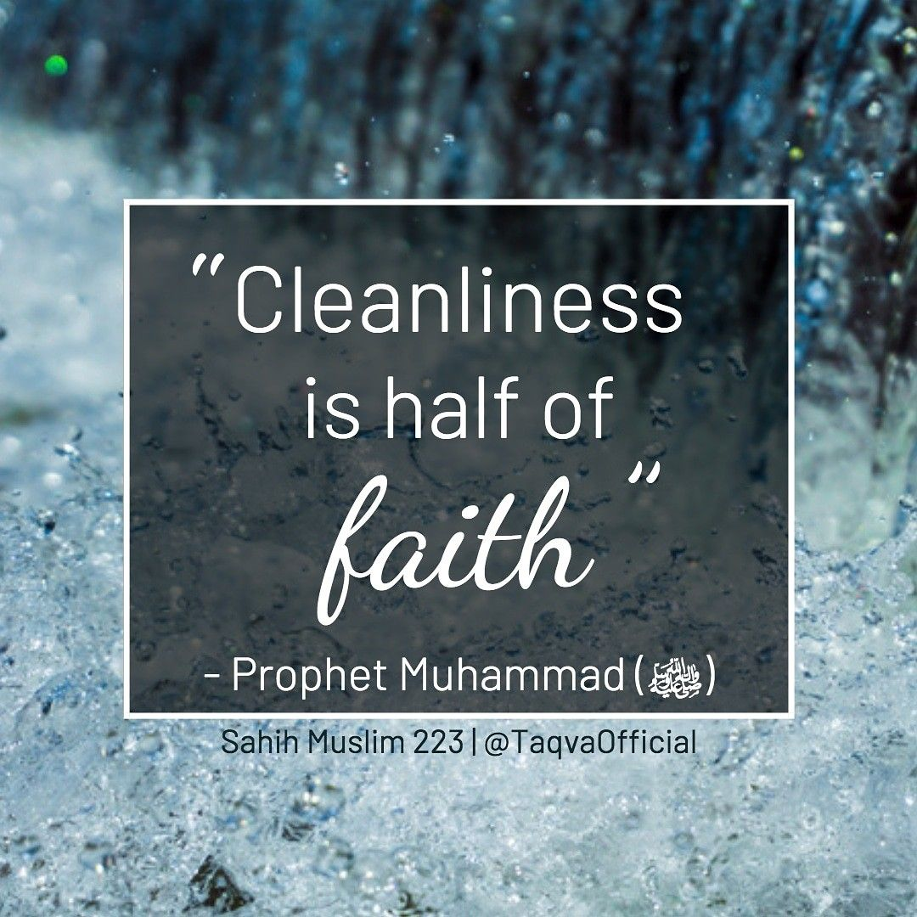

Slide 10
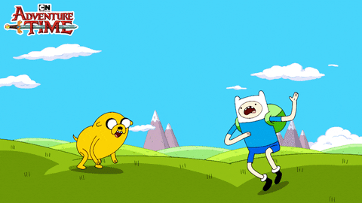
Let’s start

Slide 11
32
It makes the air dirty.
You can stop dust when you sweep the floor.
It stops bad smells. / It can help us study better.
Flies and mosquitos sit on it and carry germs.

Slide 12
32
We can clean the bathroom and toilet.
We can take out the trash.
We can take a shower after we play in the park
Don’t write in the walls.

Slide 13
33

Slide 14
33

Slide 15


Slide 16

book
Notebook
P:146+147

Slide 17

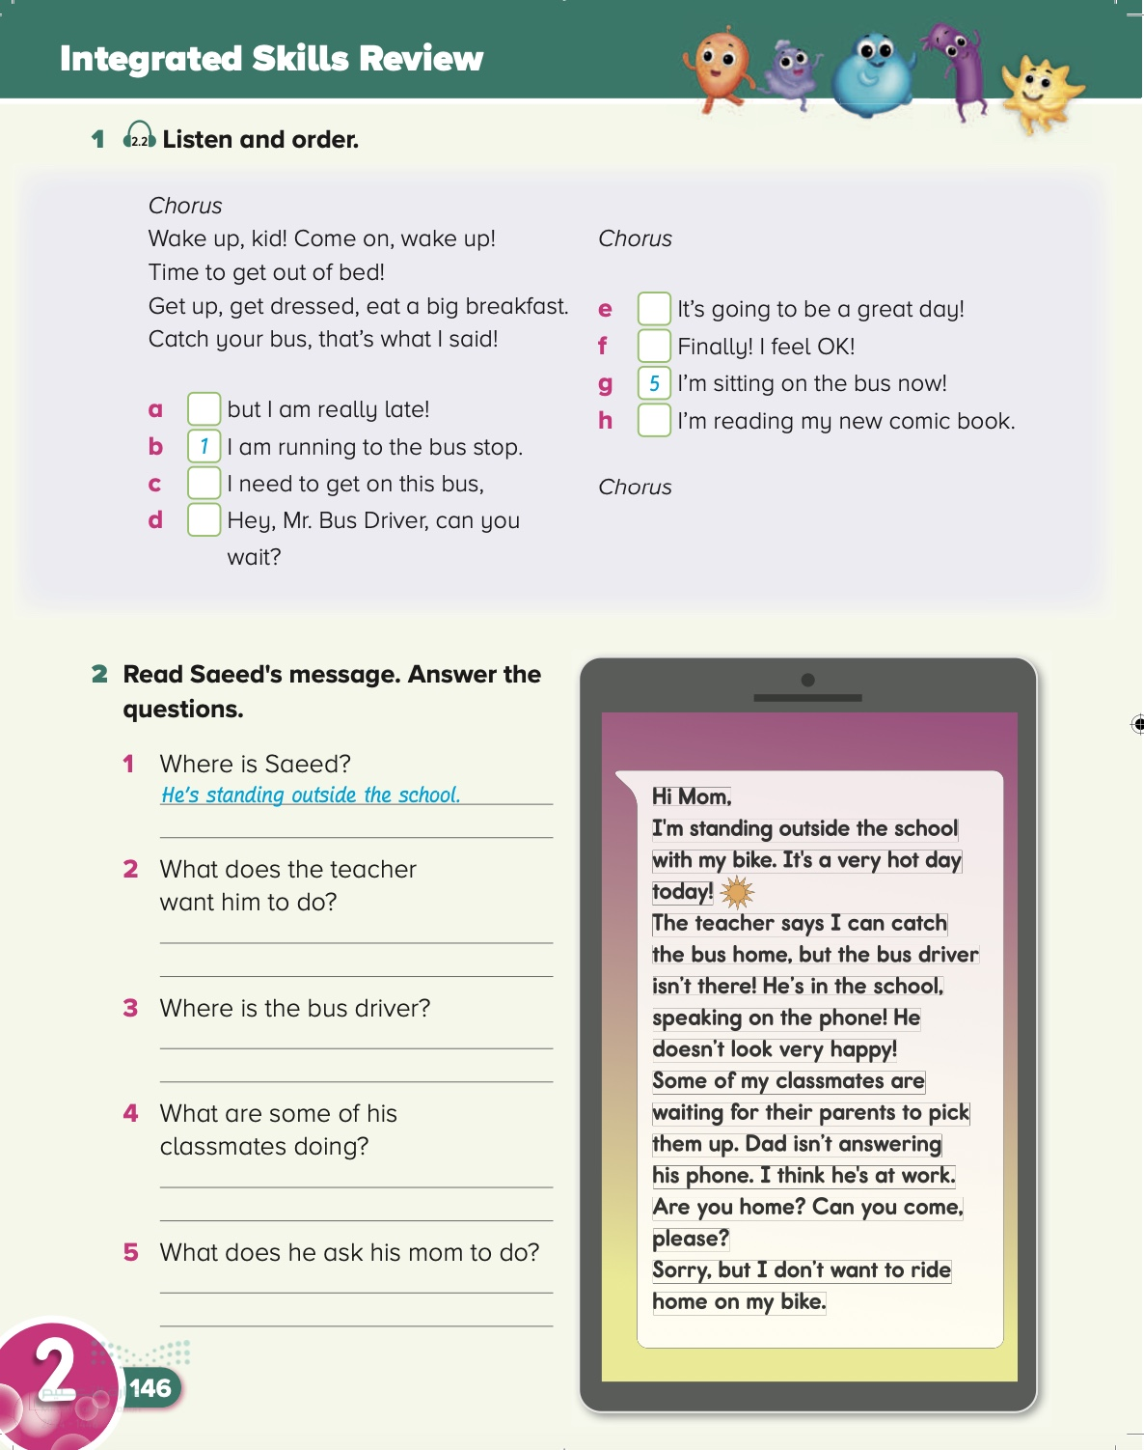
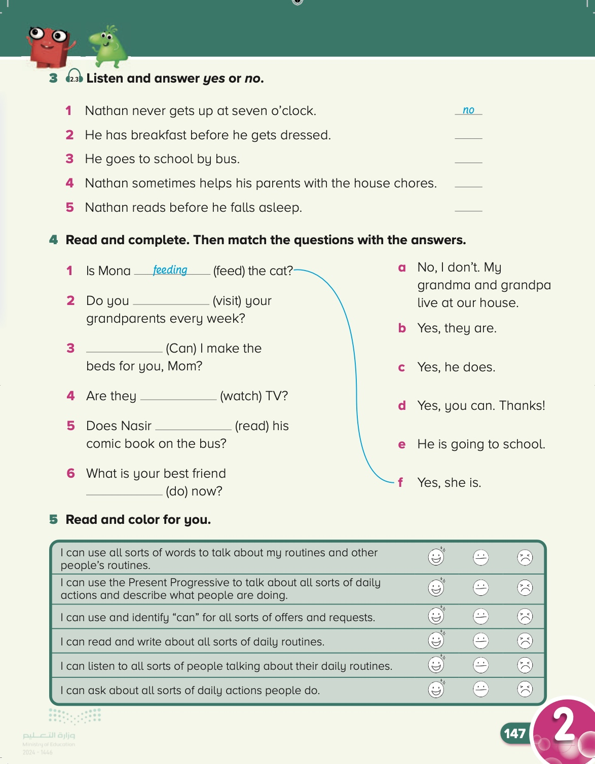
Page:
146-147

Slide 18
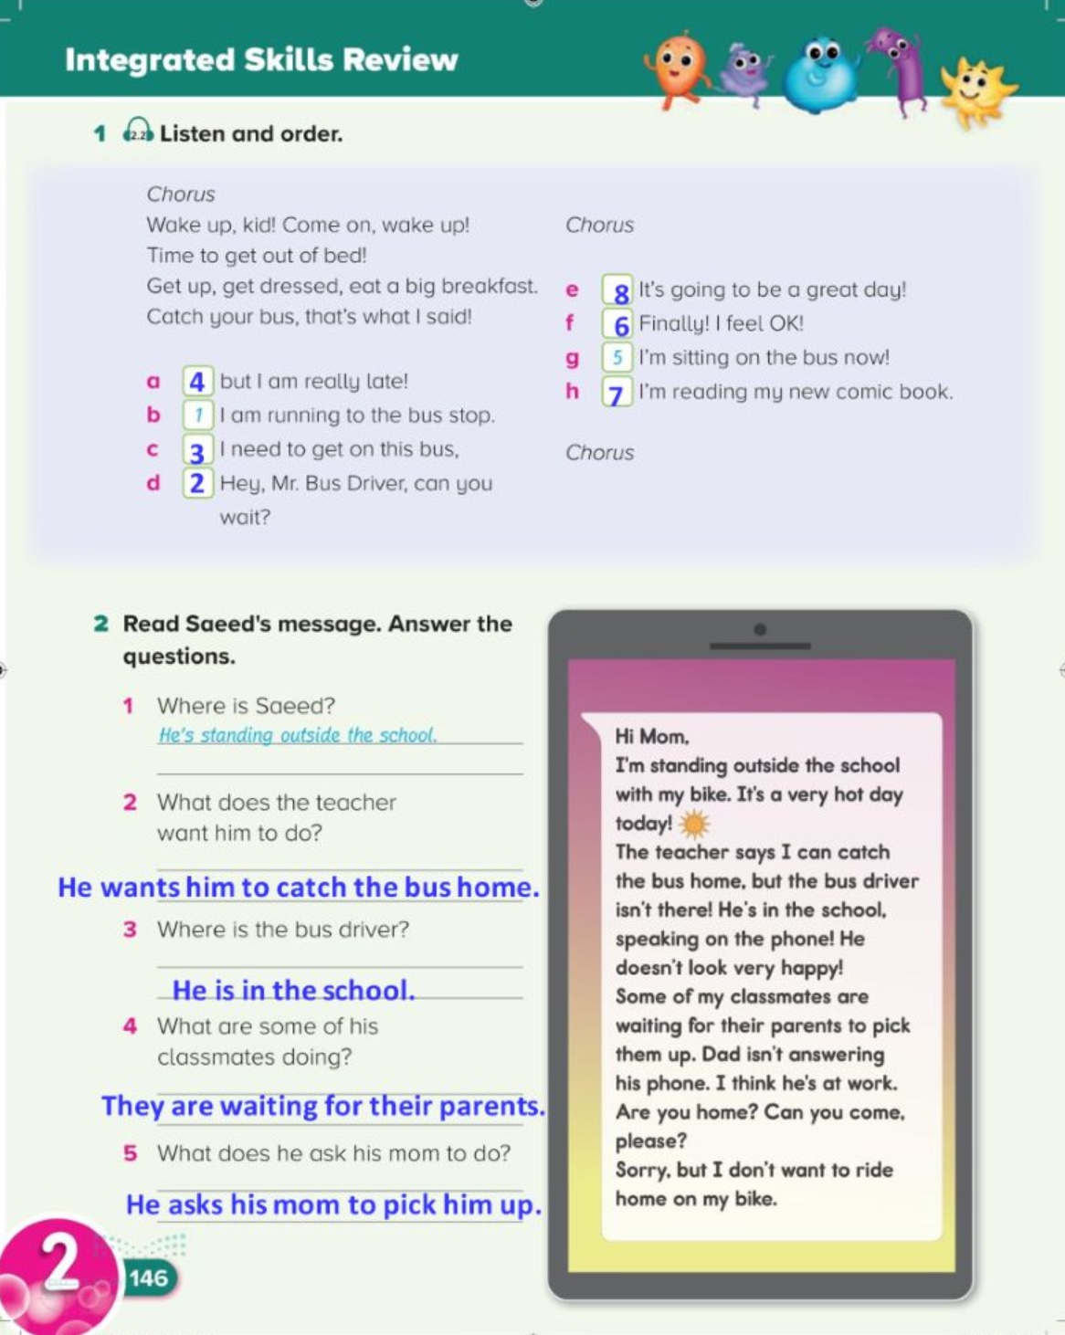
146

Slide 19
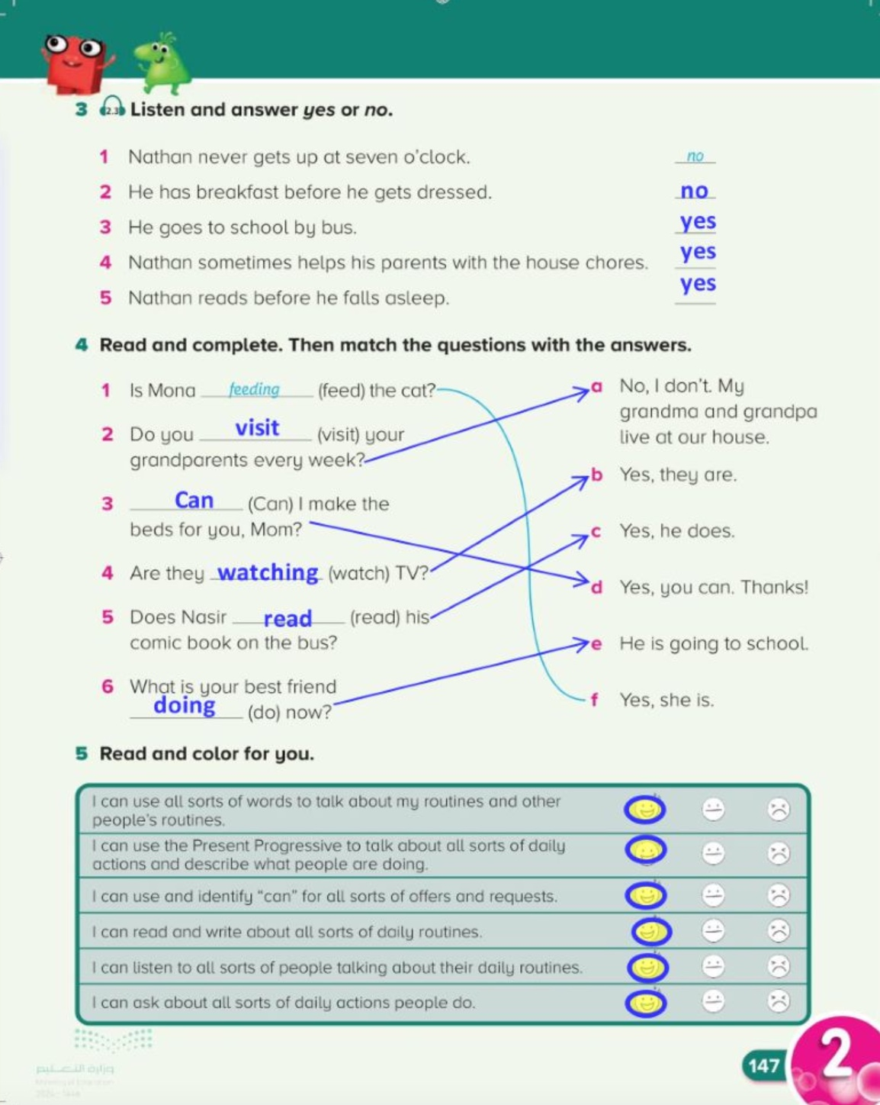
147

Slide 20


