Slide 1

Chores
Unit 2

Slide 2
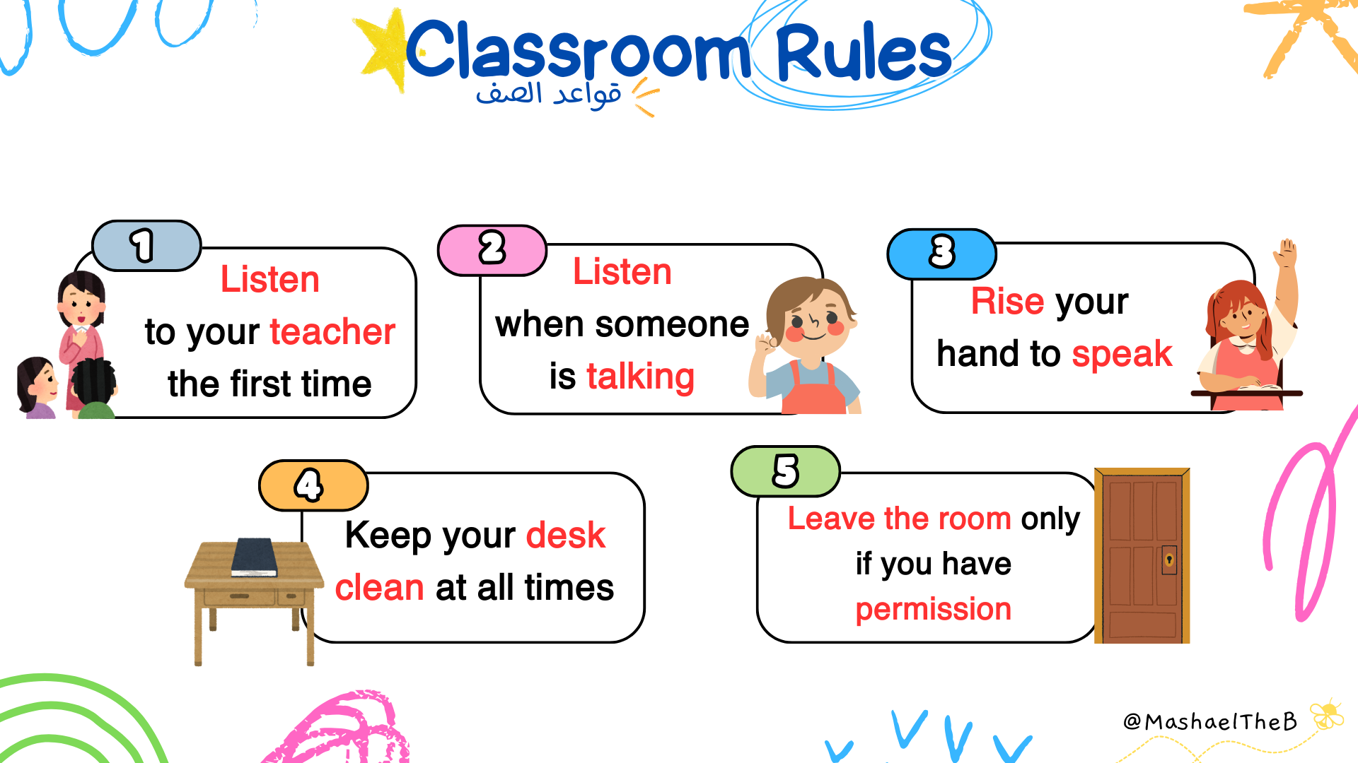

Slide 3
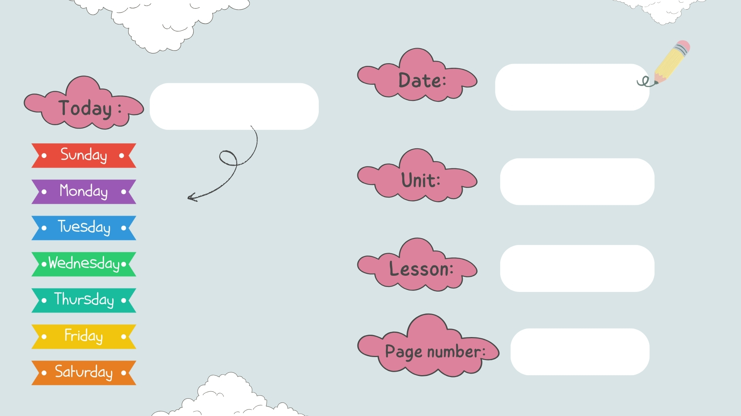
chores
grammar
24 - 25

Slide 4


Slide 5

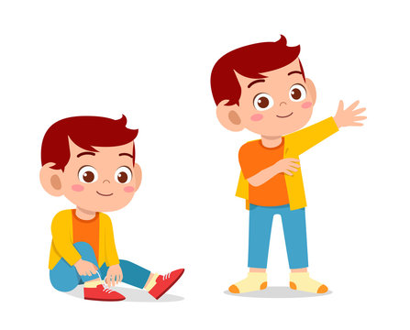
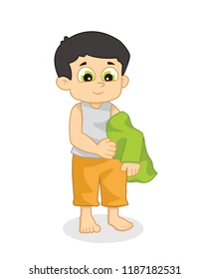
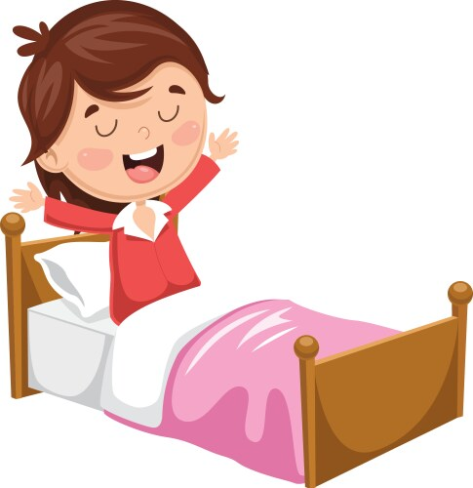
get
Get on
Get off
Get dressed
Get undressed
Get up

Slide 6
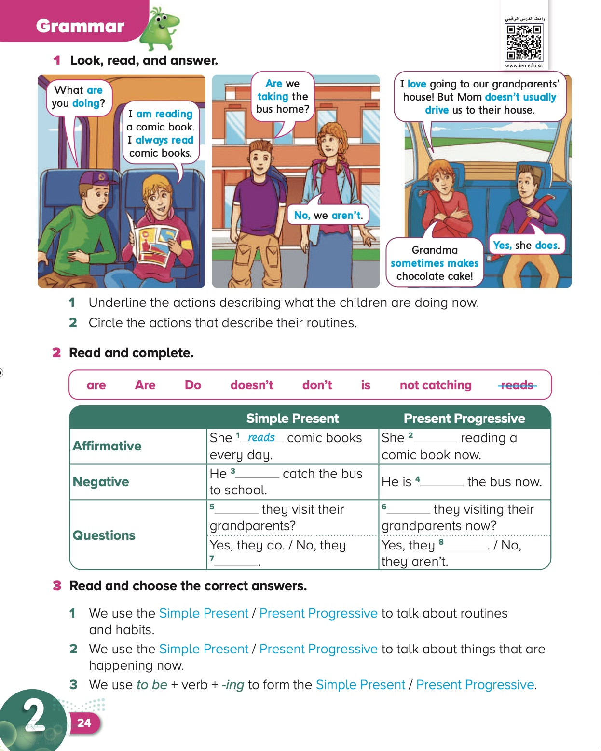
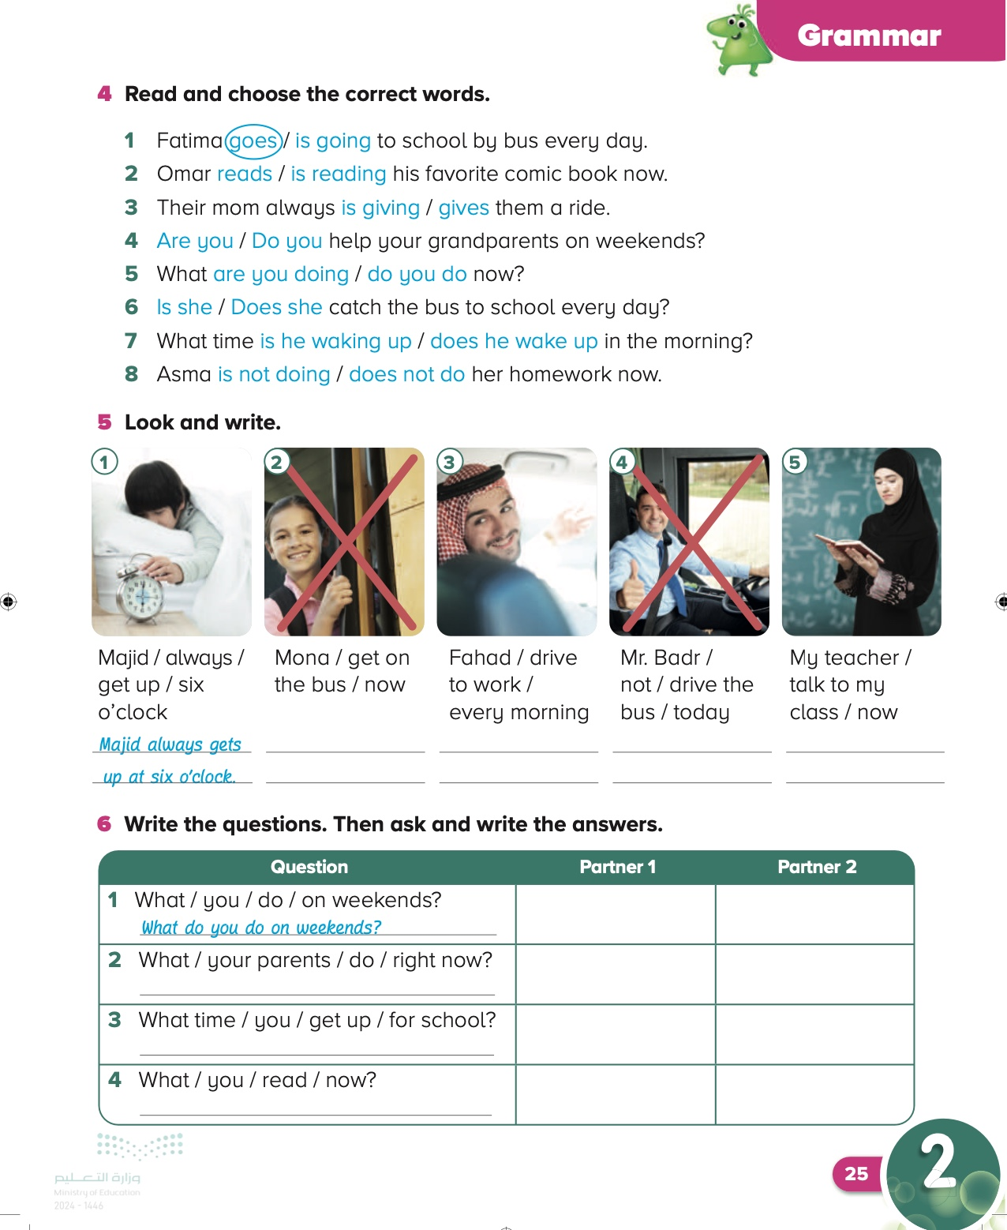
Date
Page:
2٤-2٥

Slide 7
Objective
By the end of this lesson, students should have reviewed when to use the Present Progressive and the Simple Present.
By the end of this lesson, students should be able to complete a table about what their partners usually do and are doing now.

Slide 8
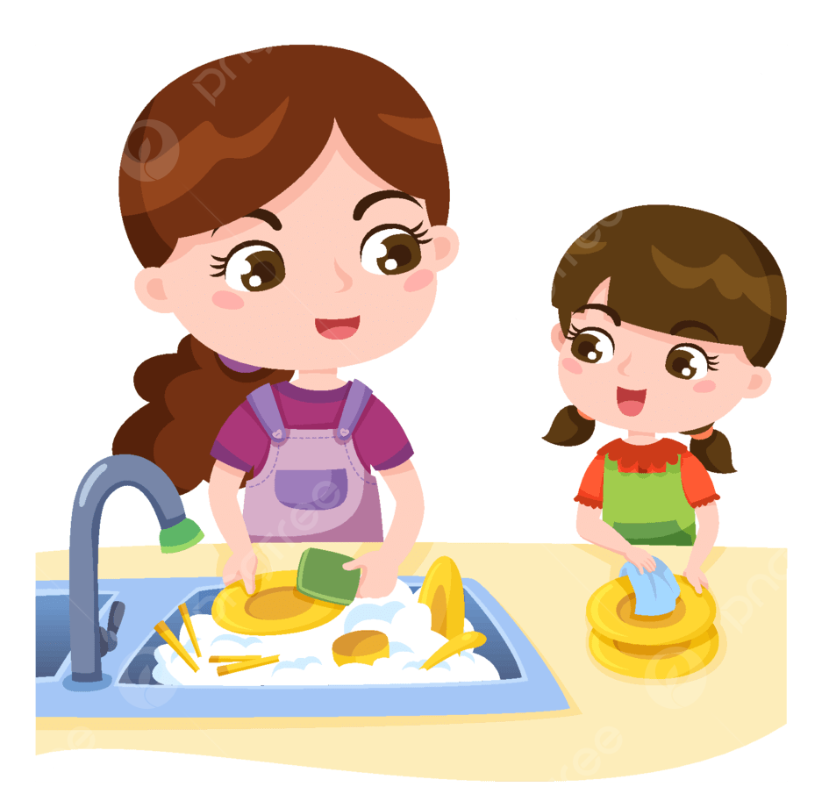
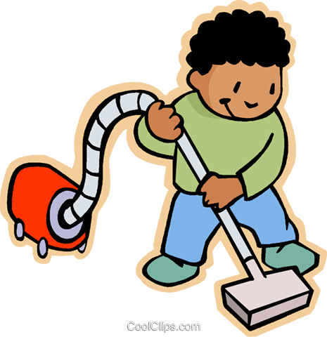
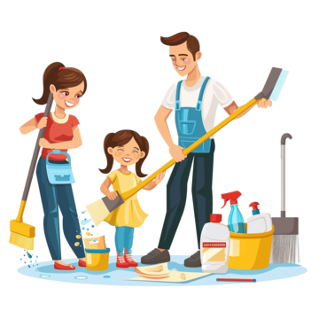
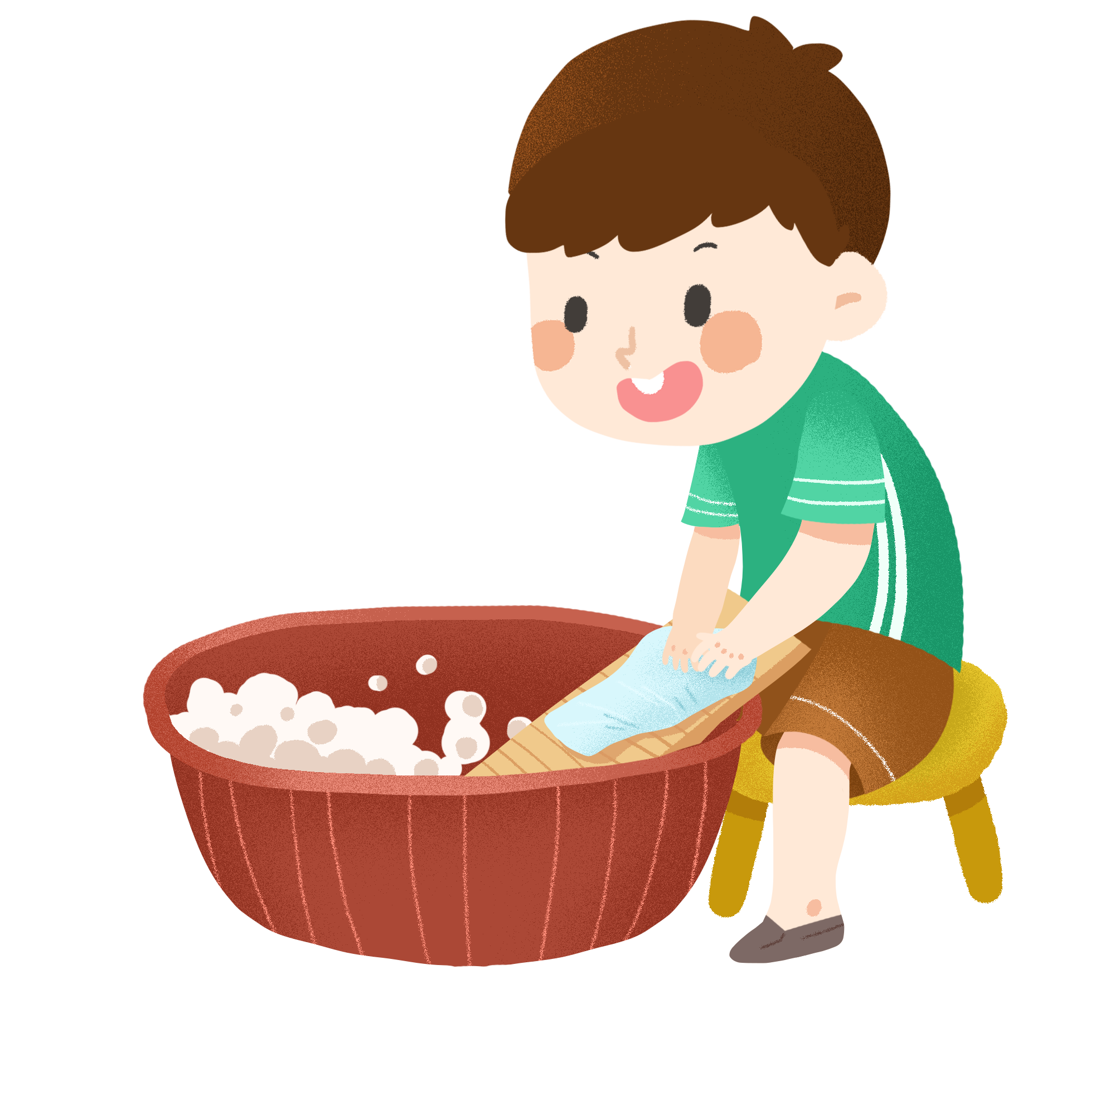
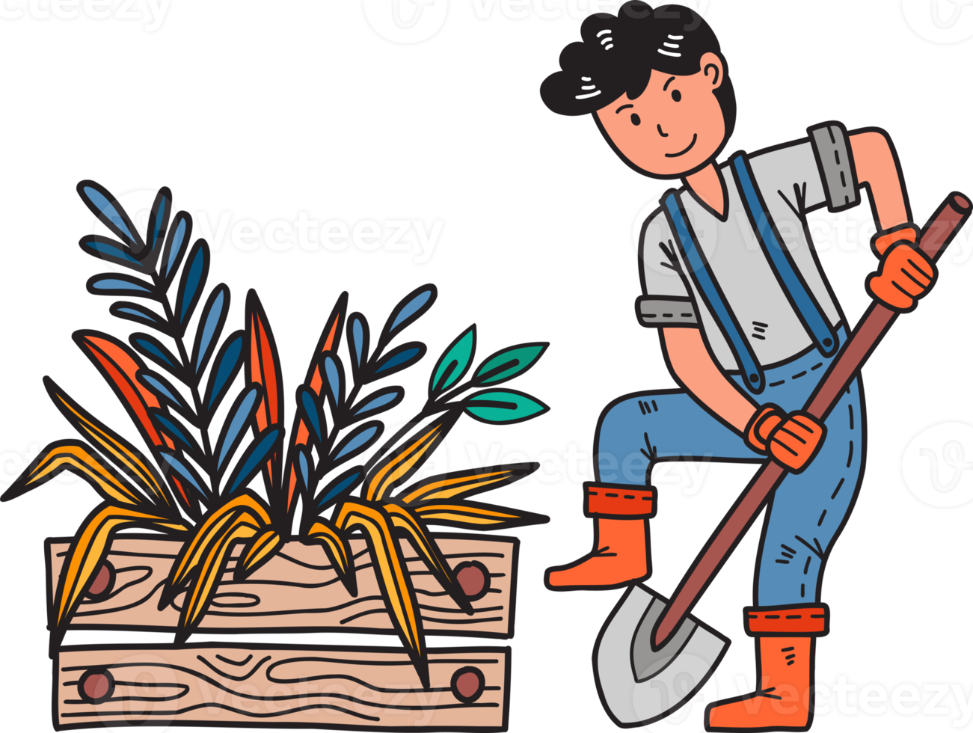
Can You Guess The Meaning Of
Chores

Slide 9
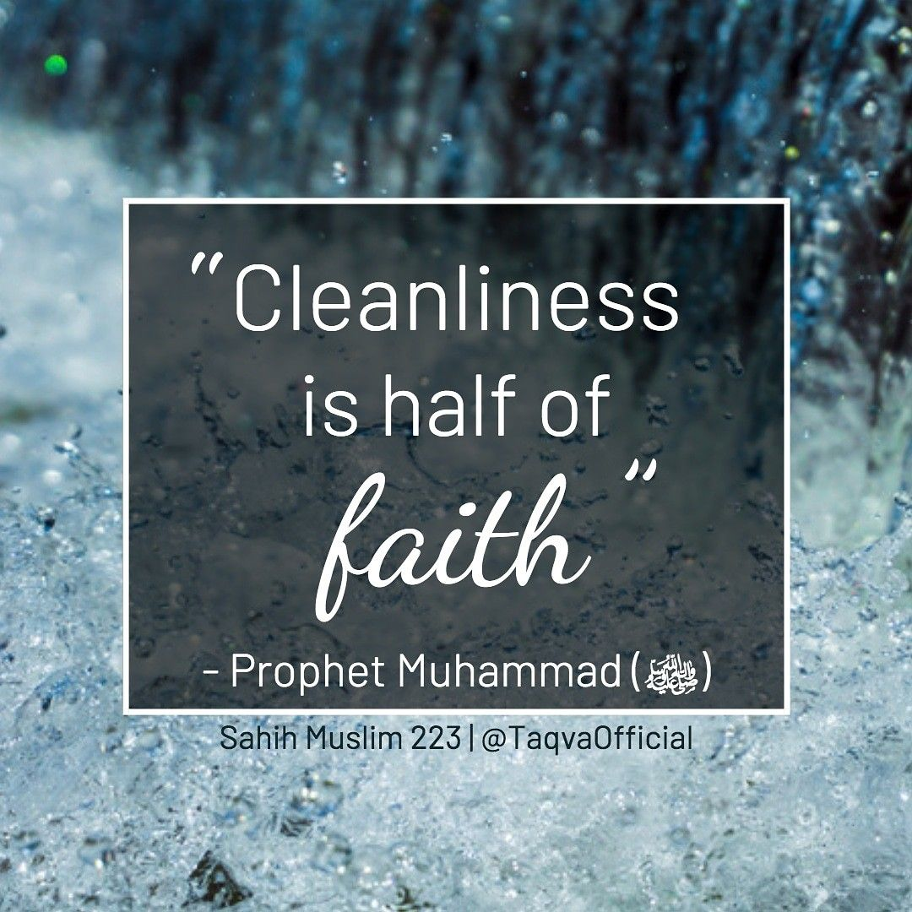

Slide 10
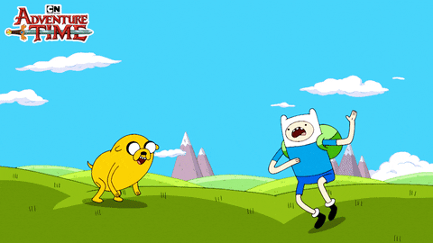
Let’s start

Slide 11
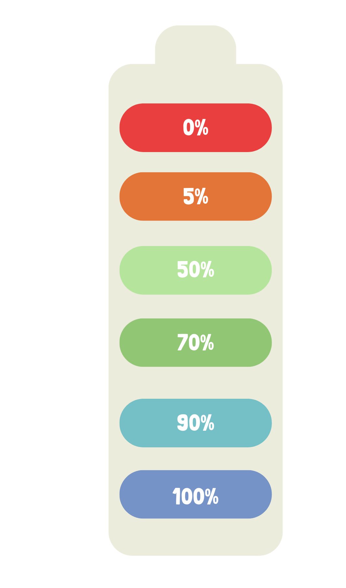
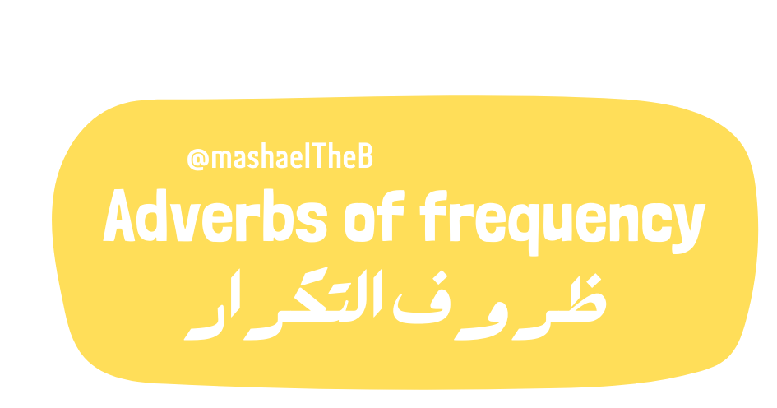
put the adverbs in the correct order
always
usually
often
sometimes
rarely
never

Slide 12
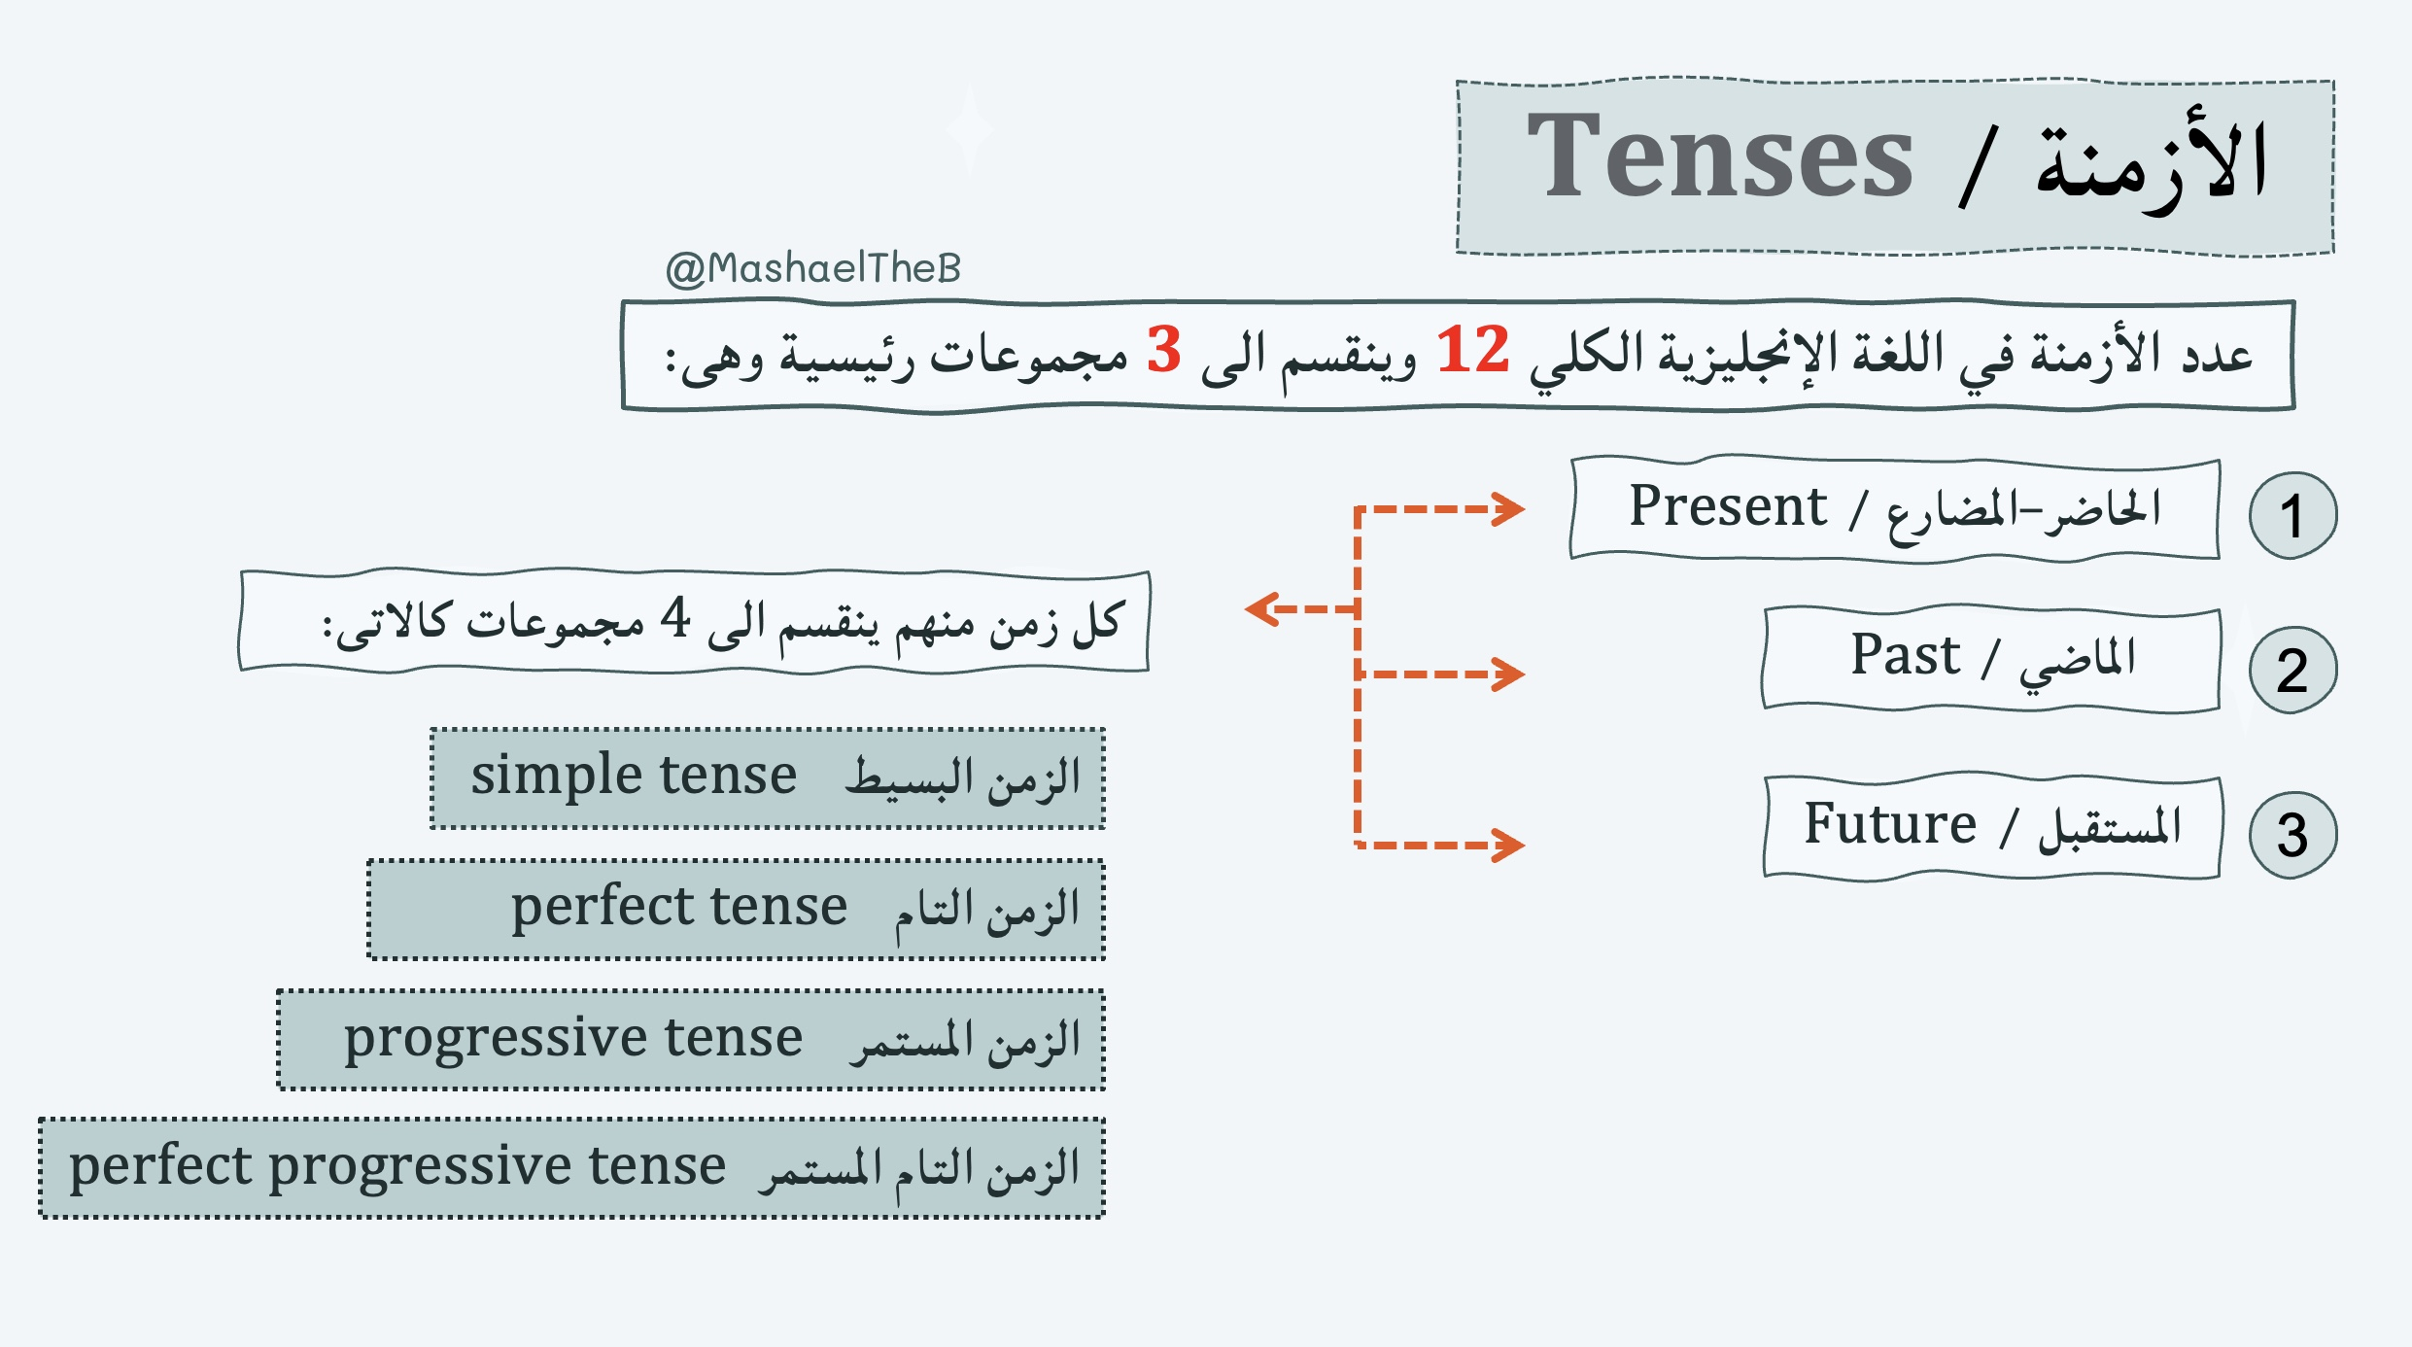

Slide 13
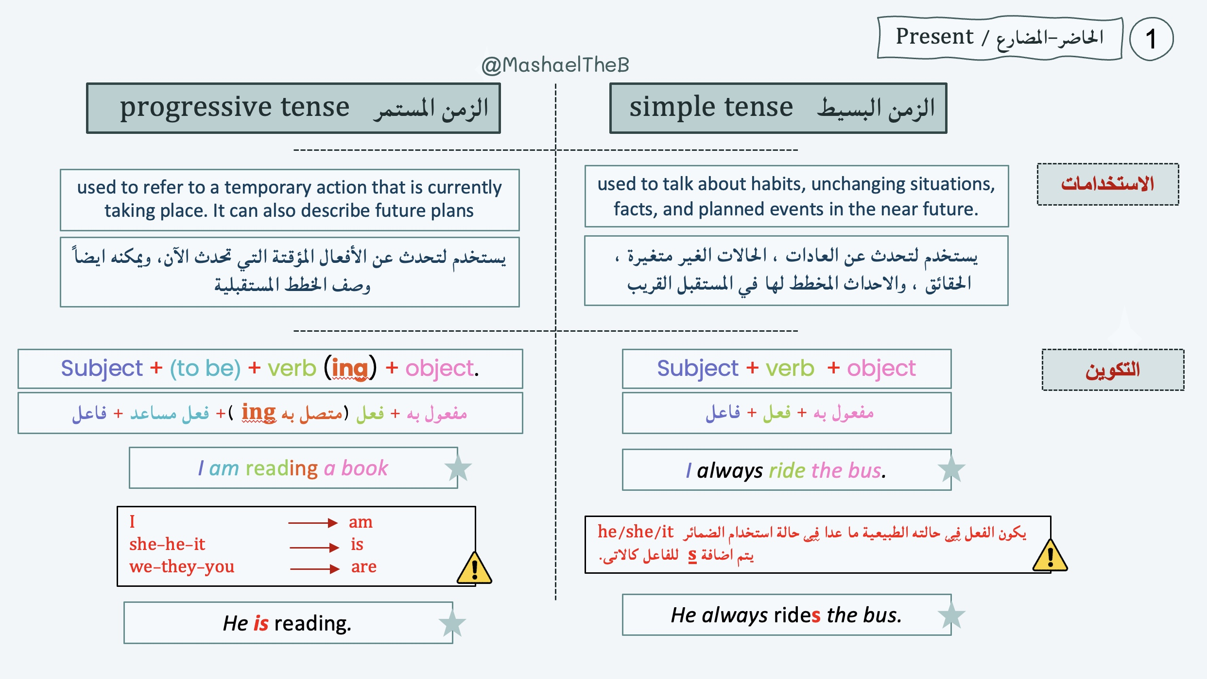
للفعل

Slide 14
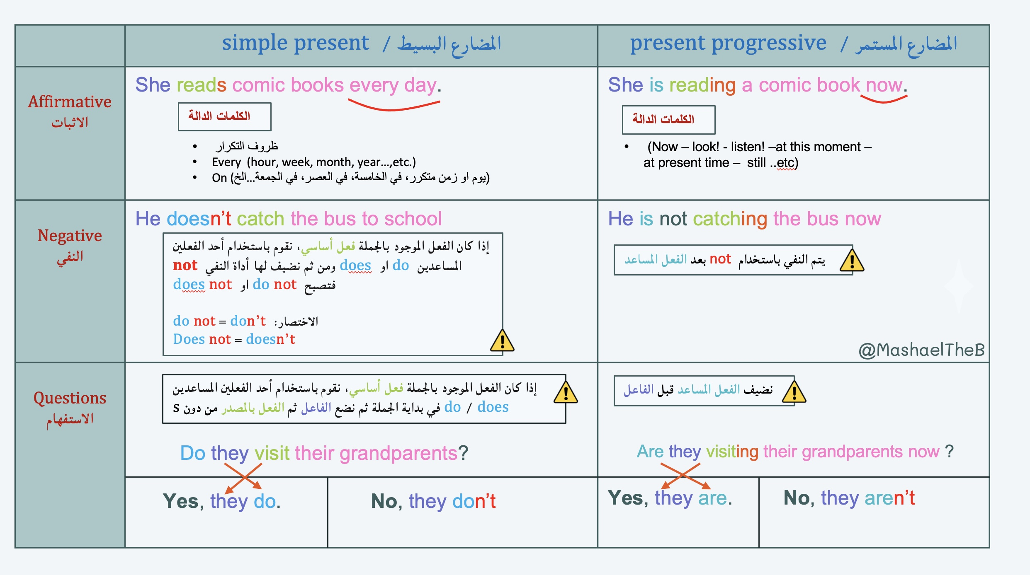

Slide 15
Which sentence is talking about now and which is talking about a habit or routine?
1
2
He always rides the bus.
He is reading.
Habit or routine
now

Slide 16
24

Slide 17
24
is
doesn’t
not catching
do
Are
are
don’t

Slide 18
25

Slide 19
25

Slide 20
25
Mona isn’t getting on the bus now
Fahad drives to work every morning
Mr. badr doesn’t driver the bus today
My teacher is talking to my class now

Slide 21
25
I play with my friends on weekend
What are your parents doing right now ?
They are sleeping right now
I get up at six o’clock every day
What time do you get up for school ?
I am reading comic book now
What are you reading now ?

Slide 22


Slide 23

book
Notebook
P:138+139

Slide 24

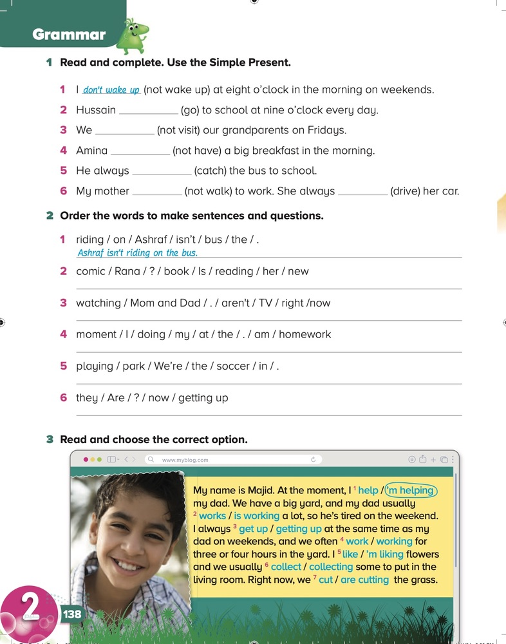
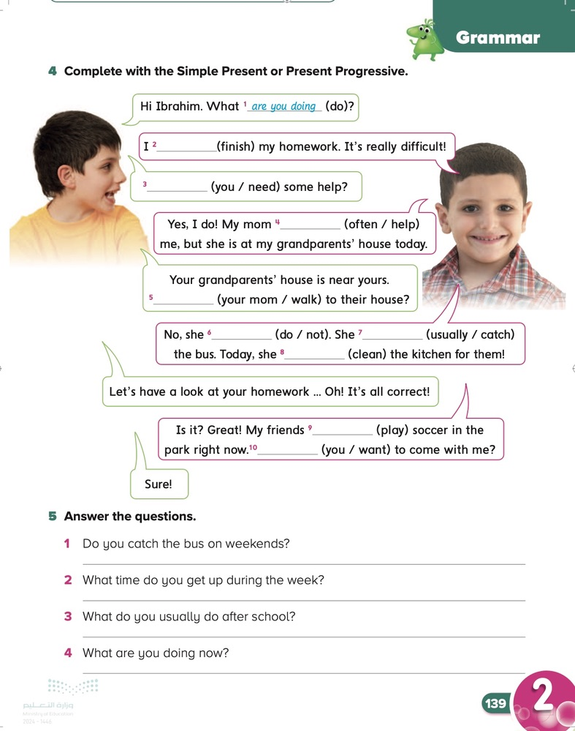
Page:
13٨-13٩

Slide 25
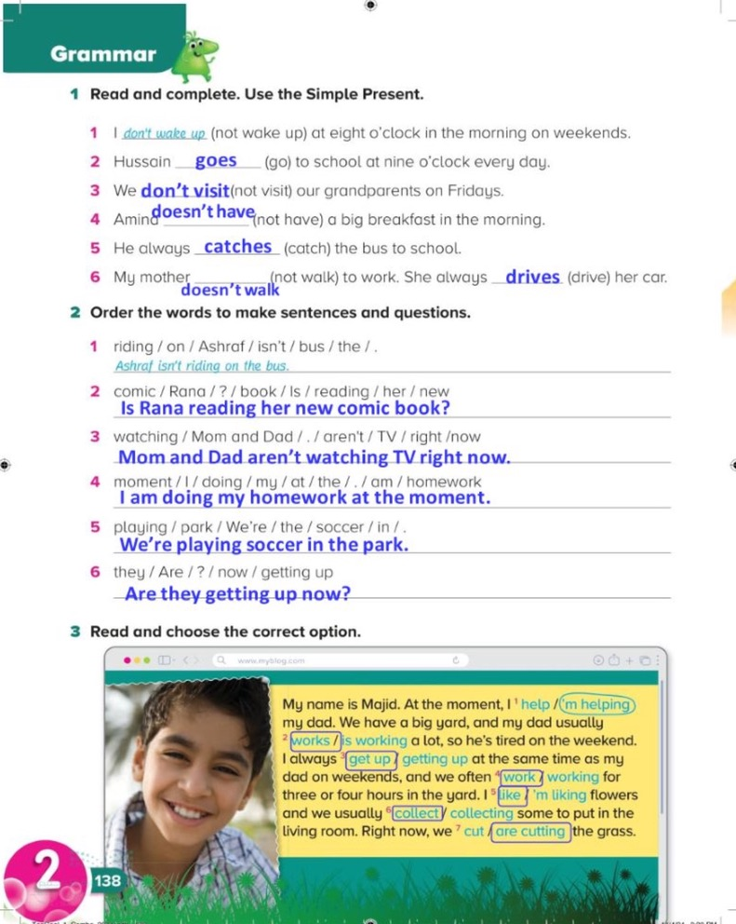
138

Slide 26
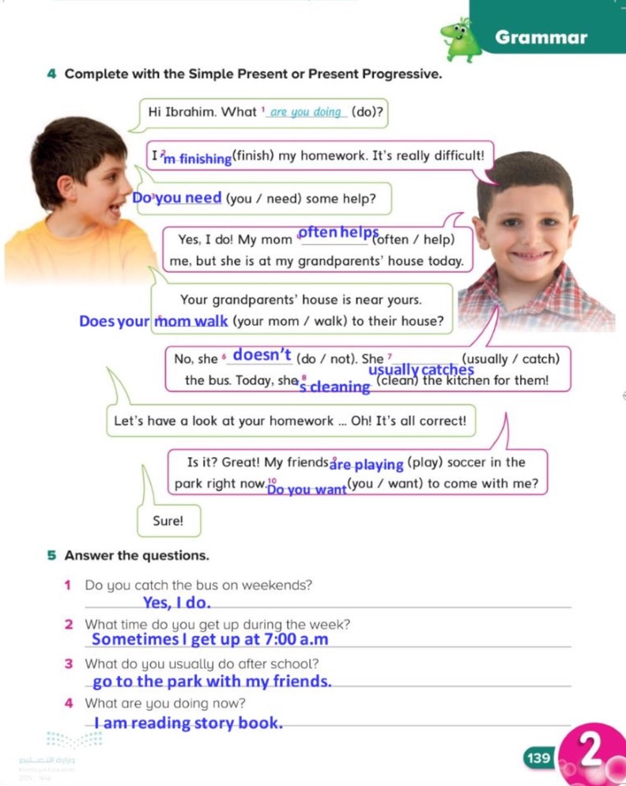
139

Slide 27


