Slide 1

Chores
Unit 2

Slide 2
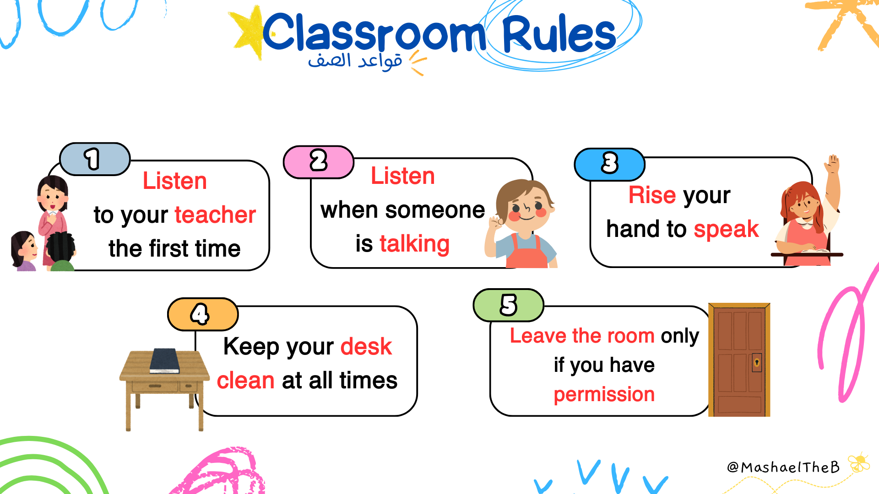

Slide 3
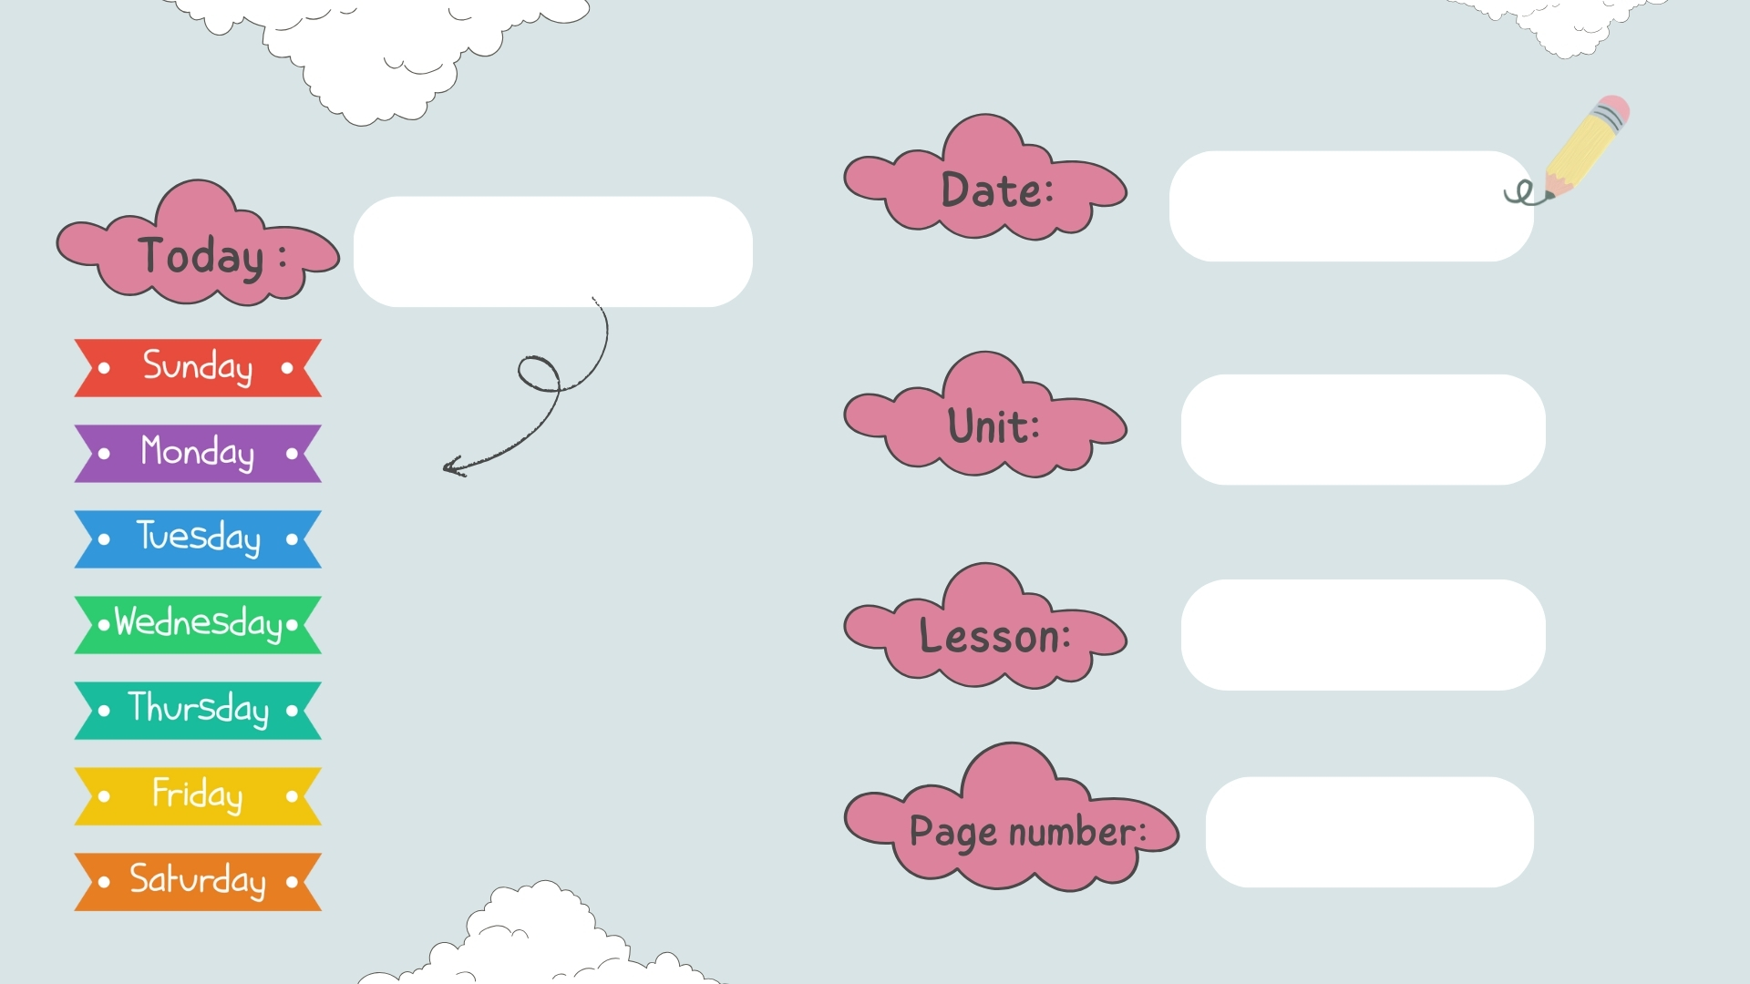
chores
Reading & writing
30 - 31

Slide 4


Slide 5
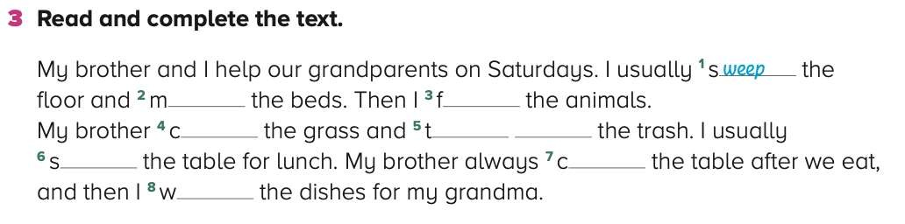
28
ake
eed
uts
ake out
et
lears
ash

Slide 6
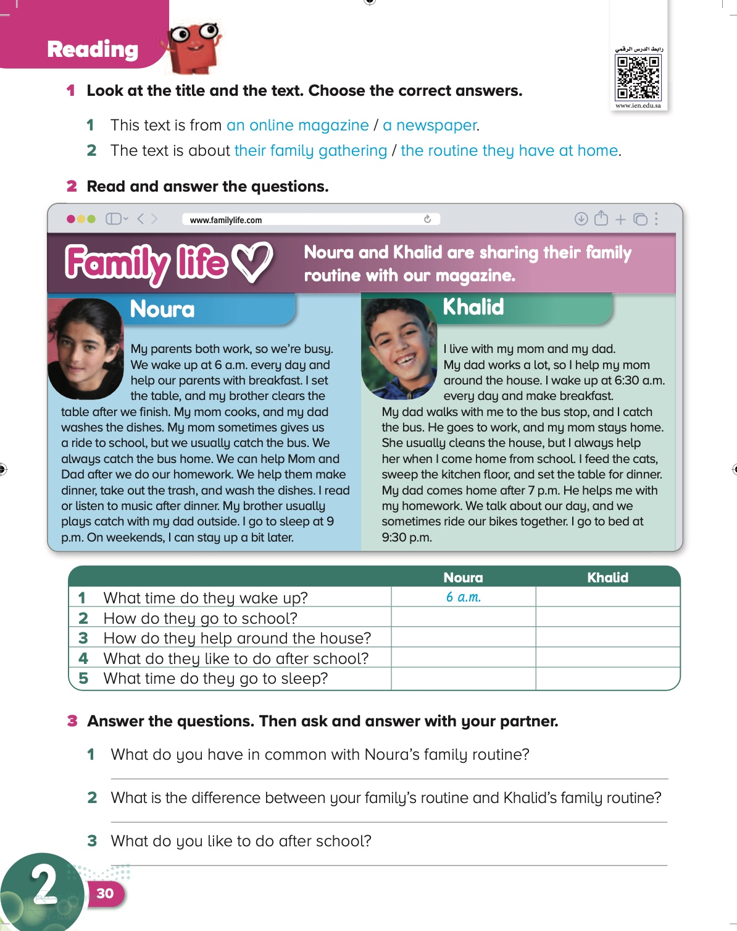
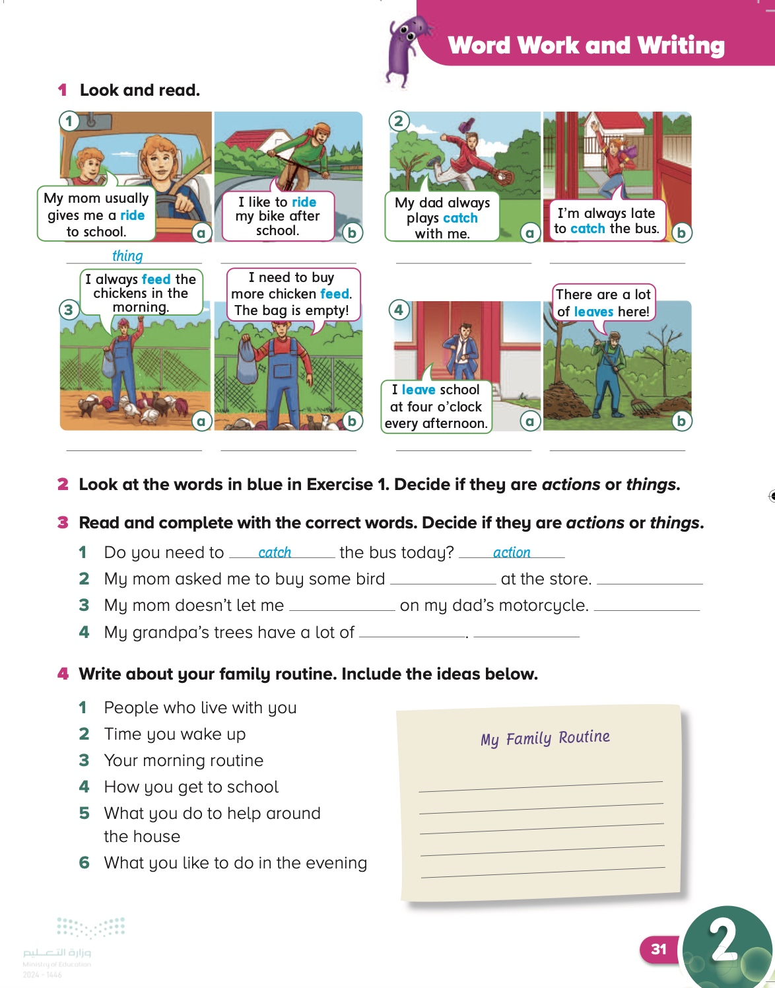
Date
Page:
30-31

Slide 7
Objective
By the end of this lesson, students should be able to read a text about family routines and compare it with their
own routine.
By the end of this lesson, students will learn to recognize, write, say words that function as nouns and verbs with the same spelling, and write about their family routine.

Slide 8
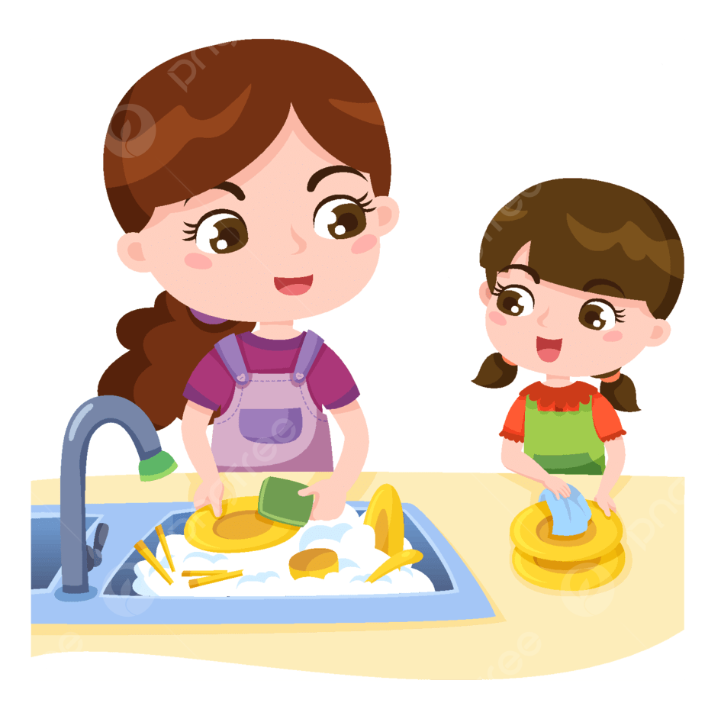
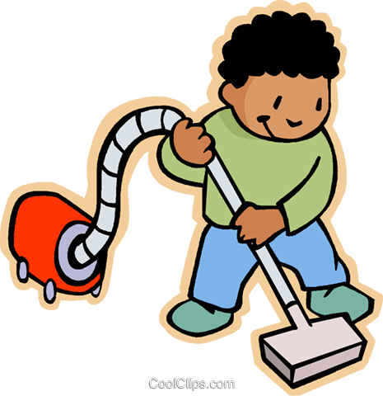
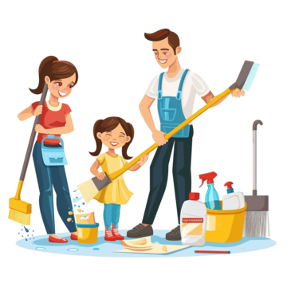
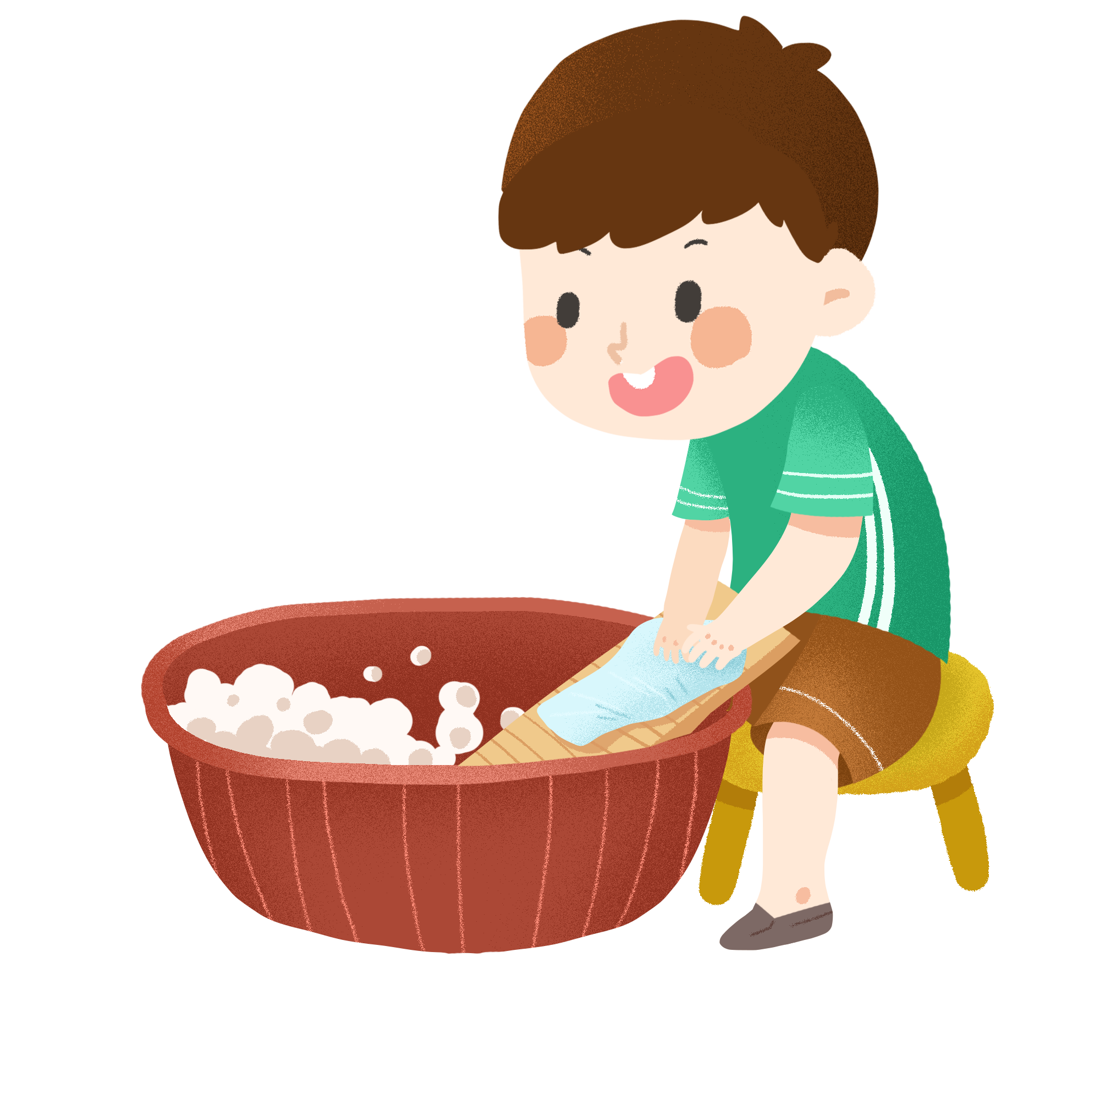
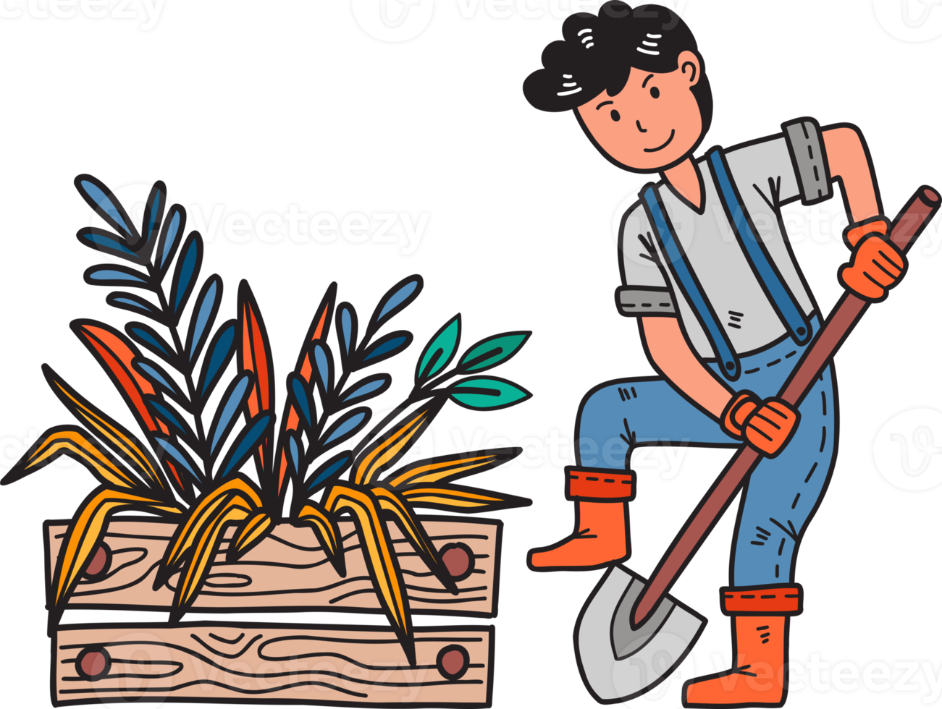
Can You Guess The Meaning Of
Chores

Slide 9
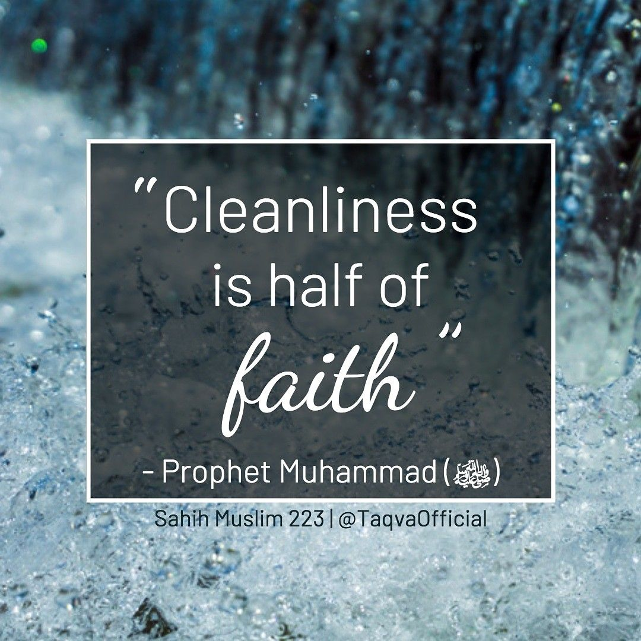

Slide 10
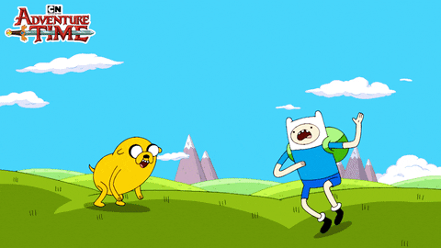
Let’s start

Slide 11
30
6:30 am
Bus and ride with mom
Bus
Make dinner
Set the table
Read books
Rides his bike
9:00 pm
9:30 pm

Slide 12
30
My mom cooks, and my dad washes the dishes.
My dad comes home after 4 p.m
I like to watch TV

Slide 13
31
action
thing
action
action
thingc
action
thing

Slide 14
31
feed
thing
ride
action
leaves
thing

Slide 15
31

Slide 16
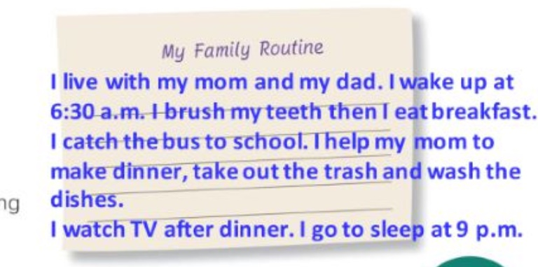
31

Slide 17


Slide 18

book
Notebook
P:144+145

Slide 19

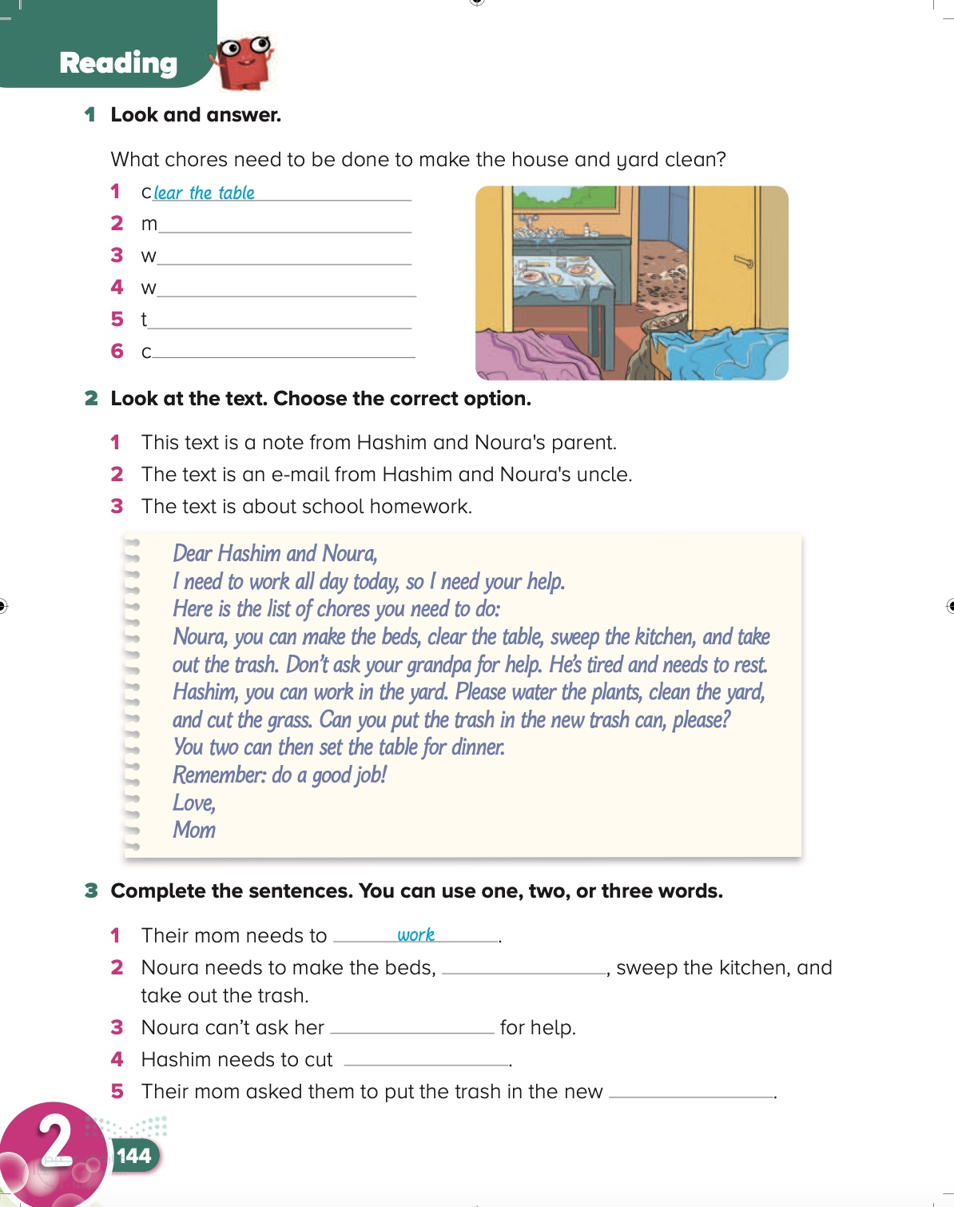
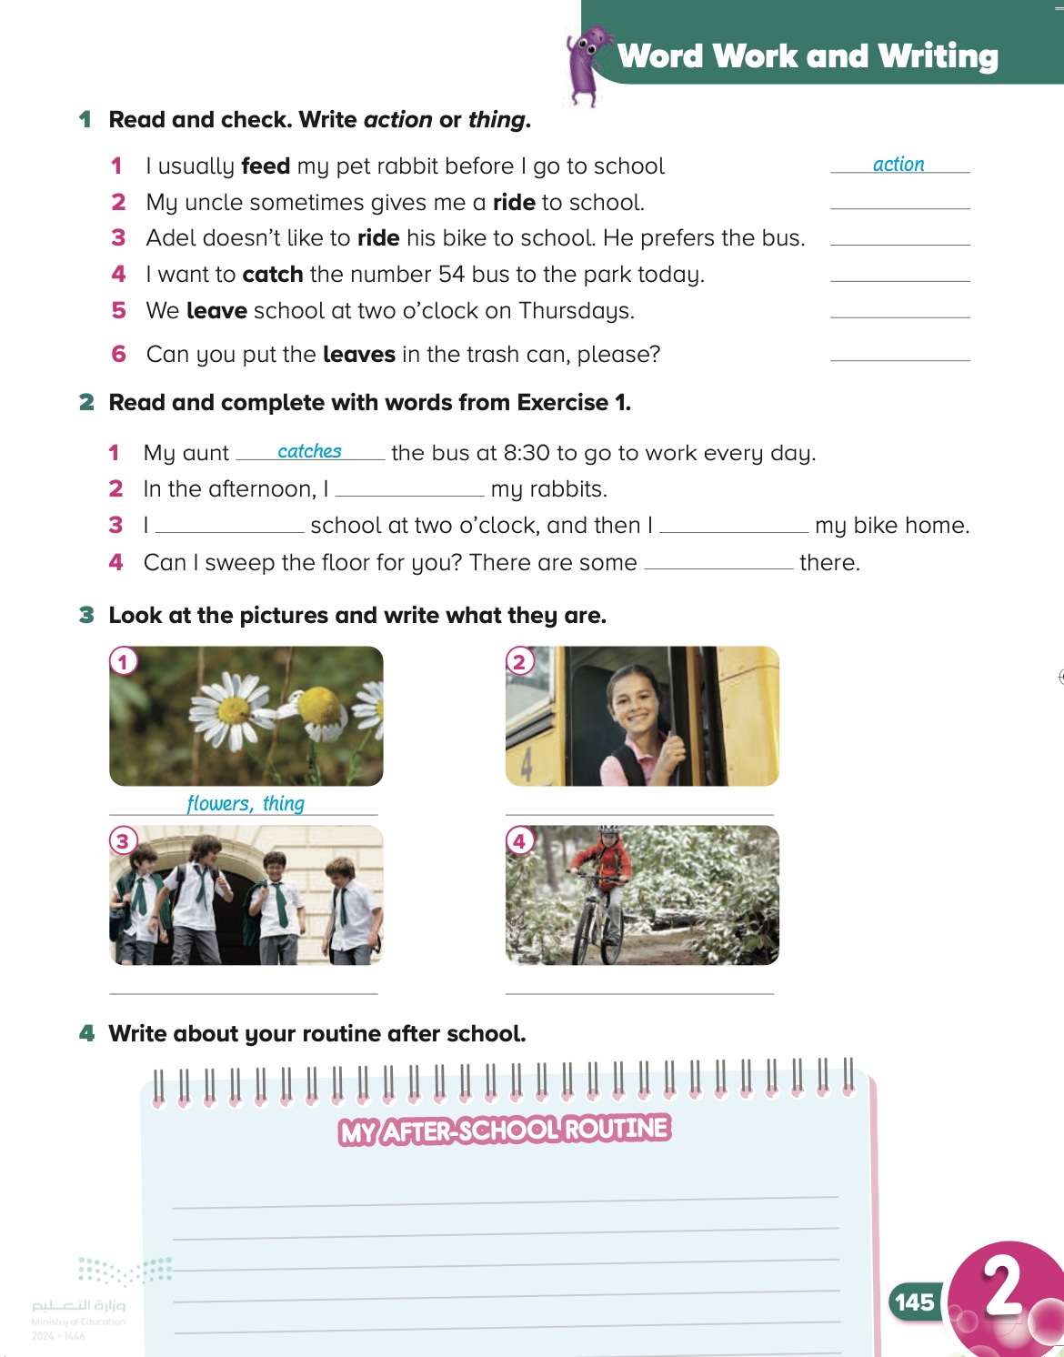
Page:
144-145

Slide 20
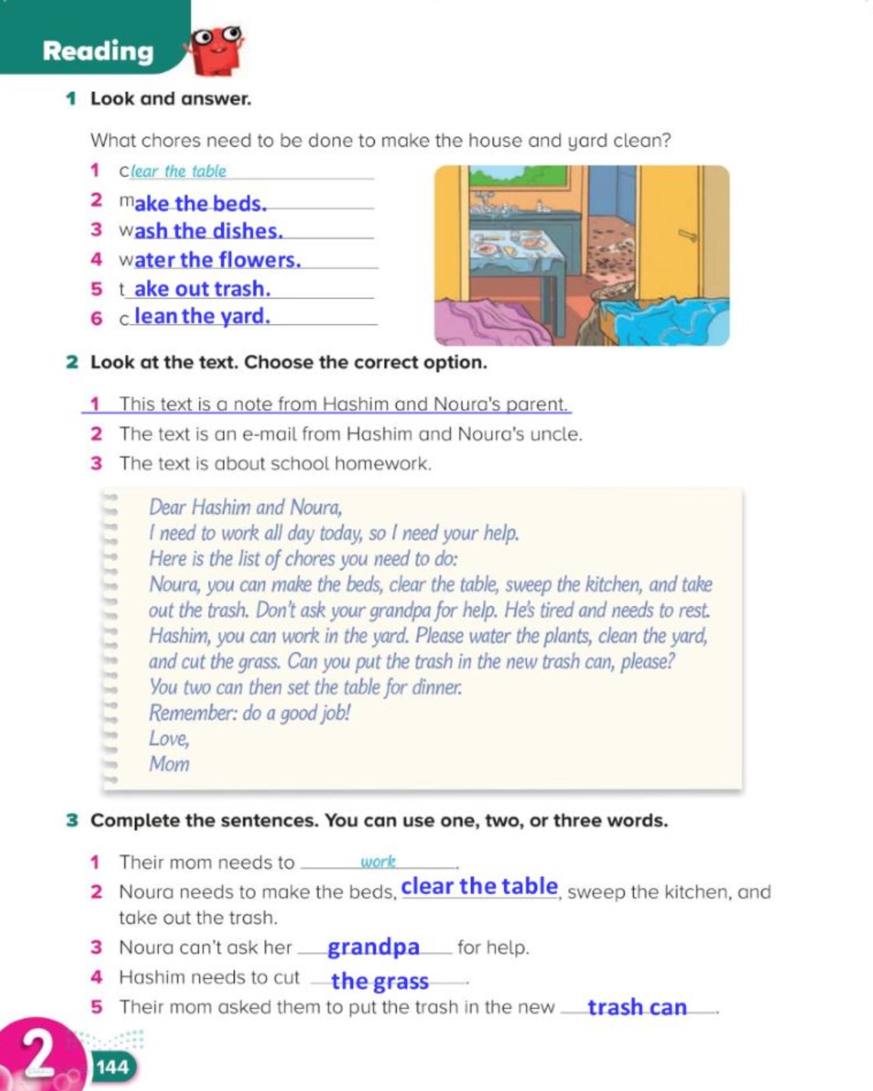
144

Slide 21
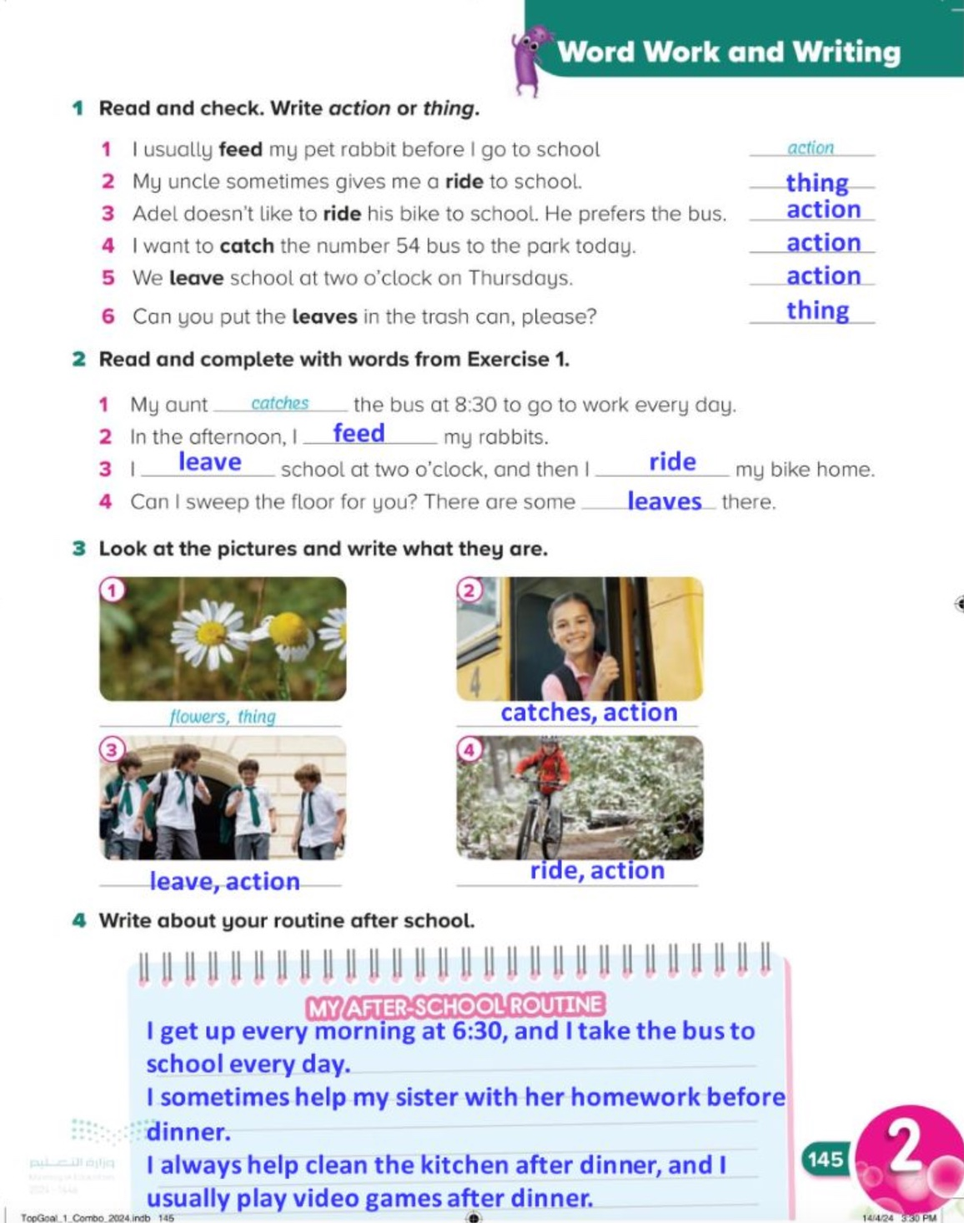
145

Slide 22


